Slide 1
Teri Gerhardt, GIS Manager
January 2018

Slide 2
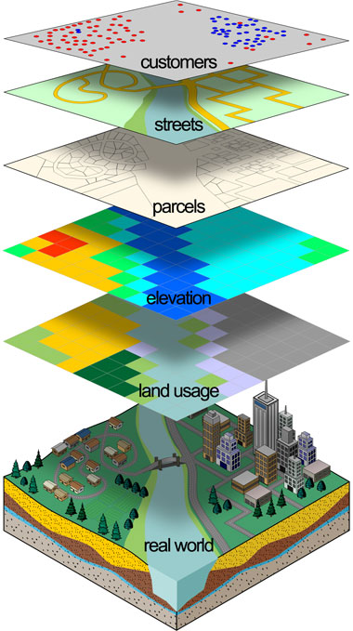
Geographic Information Systems
Captures
Manages
Analyzes
Displays
Tells a story in an easily understood format – on a map!

Slide 3
Web Maps for Citizens
Various applications using GIS to enhance Citizen Engagement
Property Info
311
BuildingEye
Service Finder
Park Finder
Road Closures
Capital Improvement Projects
Development Activity Map
More

Slide 4
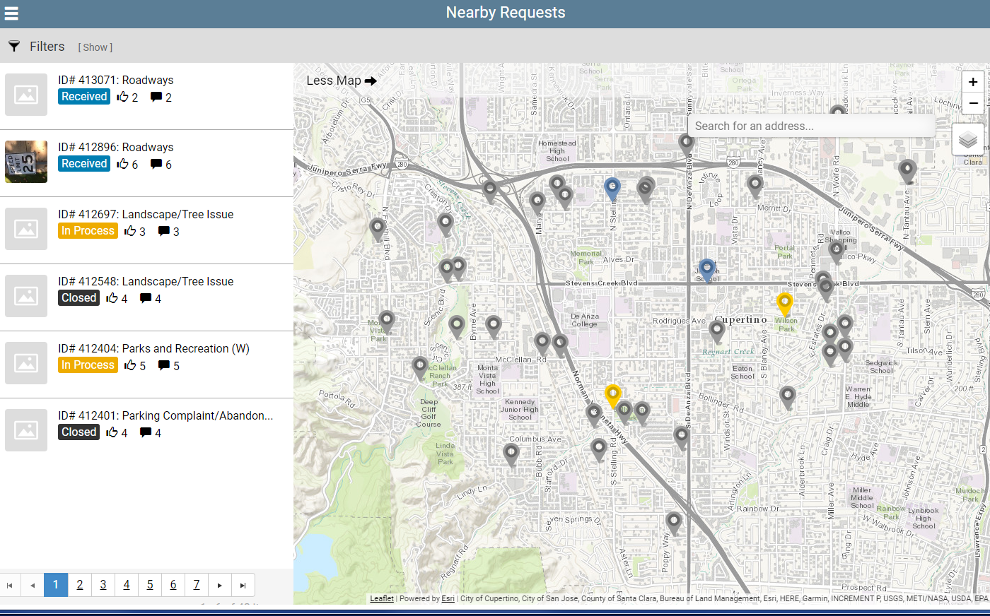
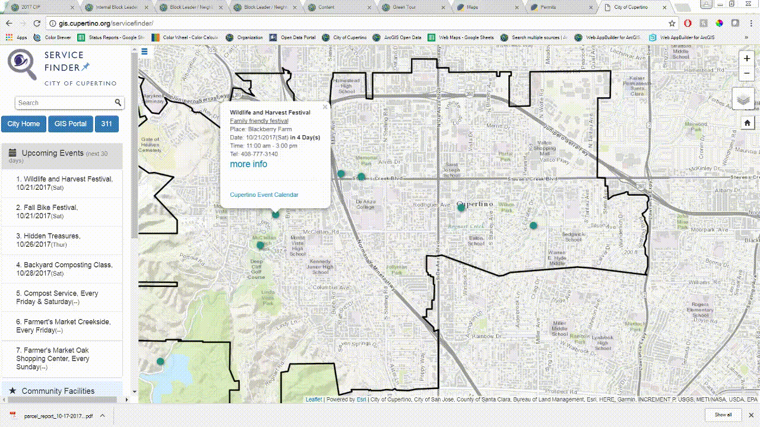
Service Finder / Cupertino 311

