Slide 1
City of Cupertino
Community Development Department

Slide 2
Community Development Department
  Planning
  Building
  Housing
  Economic Development
  Code Enforcement
Notes:
The Community Development Department oversees Planning, Building, Housing, Economic Development and Code Enforcement
Planning’s primary responsibilities of the Planning Division are to assist the community to plan and foresee future land uses and policies and to review current development proposals for conformance with the City’s adopted policies and ordinances. The Planning Division administers land use regulations while striving to enhance the livability of Cupertino by fostering a healthy, prosperous and sustainable community environment.

Slide 3
Community Development Department
  How to participate:
  Visit www.cupertino.org
  Sign up for e-notification
  Email us: planning@cupertino.org to ask a question or to make an appointment
Notes:
There are a number of ways to engage the with the department. You may:
Visit us at Cupertino.org
Sign up for e-notification
Or email us at planning@Cupertino.org

Slide 4
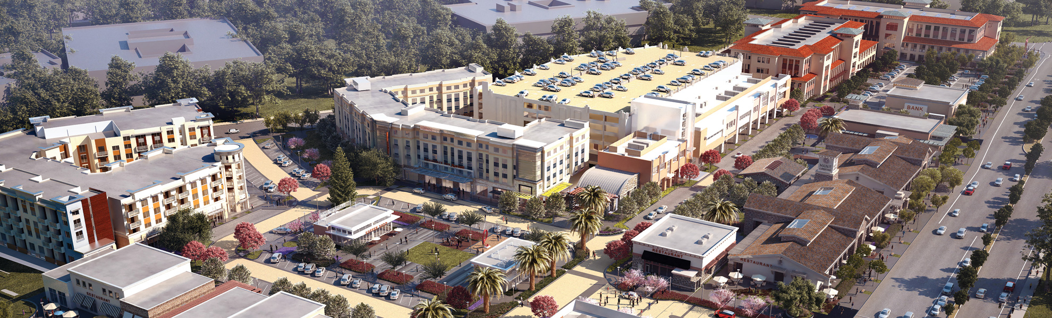
Main Street Cupertino
  180 room hotel, 260K sq. ft. of office, 130.5k sq. ft. of retail, and 120 apartment units
  Tenants include: Lazy Dog, Philz Coffee, Eureka!, Alexander’s, Pieology, 85 Degrees, and much more
Notes:
180 room hotel, 260Ks.f. office, up to 130.5Ks.f. retail and 120 apt units.
List of retailers: Lazy Dog, Philz Coffee, Eureka!, Alexander’s, Pieology, Rootstock, 85 Degrees, Capezio, Howard’s Shoes, Oren’s Hummus, Panino Giusto, Meet Fresh Tea Chansii, AT&T, Chef Hung, Target, Meriwest, Pressed Juicery

Slide 5
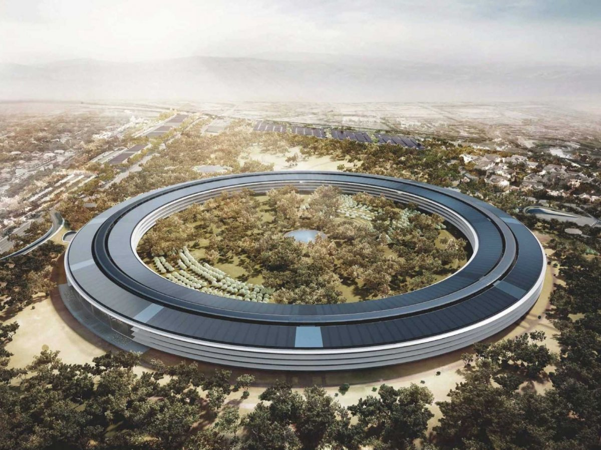
Apple Campus 2 (AC2)
  Replace 2.6 million sq. ft. of office space with 3.4 million sq. ft. that includes a 1,000 seat auditorium, fitness center, parking facility and R&D offices
Notes:
Replace 2.6Ms.f. with 3.4M s.f.: 2.82M s.f. office, 1,000 seat auditorium, Fitness Center & Parking & 600Ks.f. R&D offices.

Slide 6
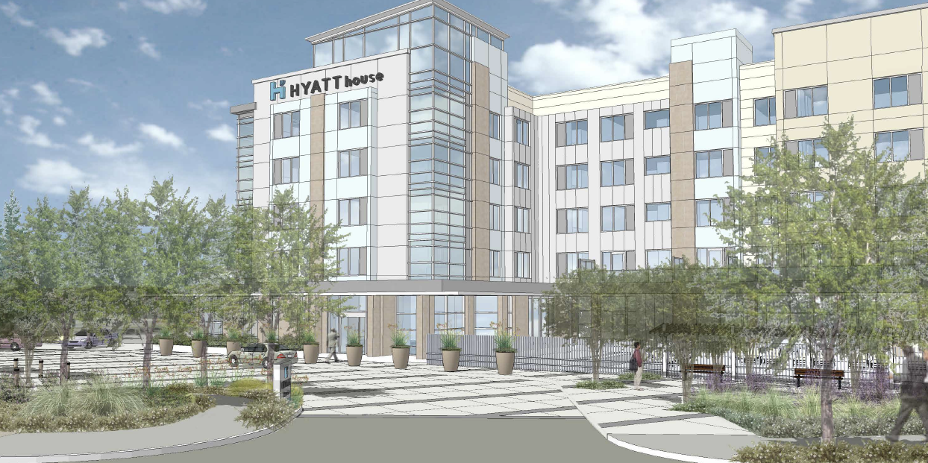
Hyatt House Hotel
  148-room hotel with restaurant, bar, and conference rooms
Notes:
148-room hotel with restaurant and bar and conference room space

Slide 7
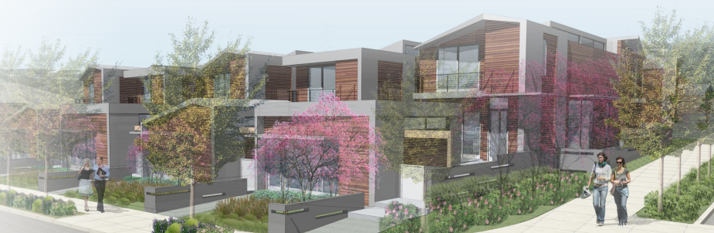
Foothill Live/Work
  New six (6) townhomes with five (5) detached work spaces
Notes:
DP, ASA, Z, TM, and TR to construct 6 townhomes (5 w/ detached work spaces)

Slide 8
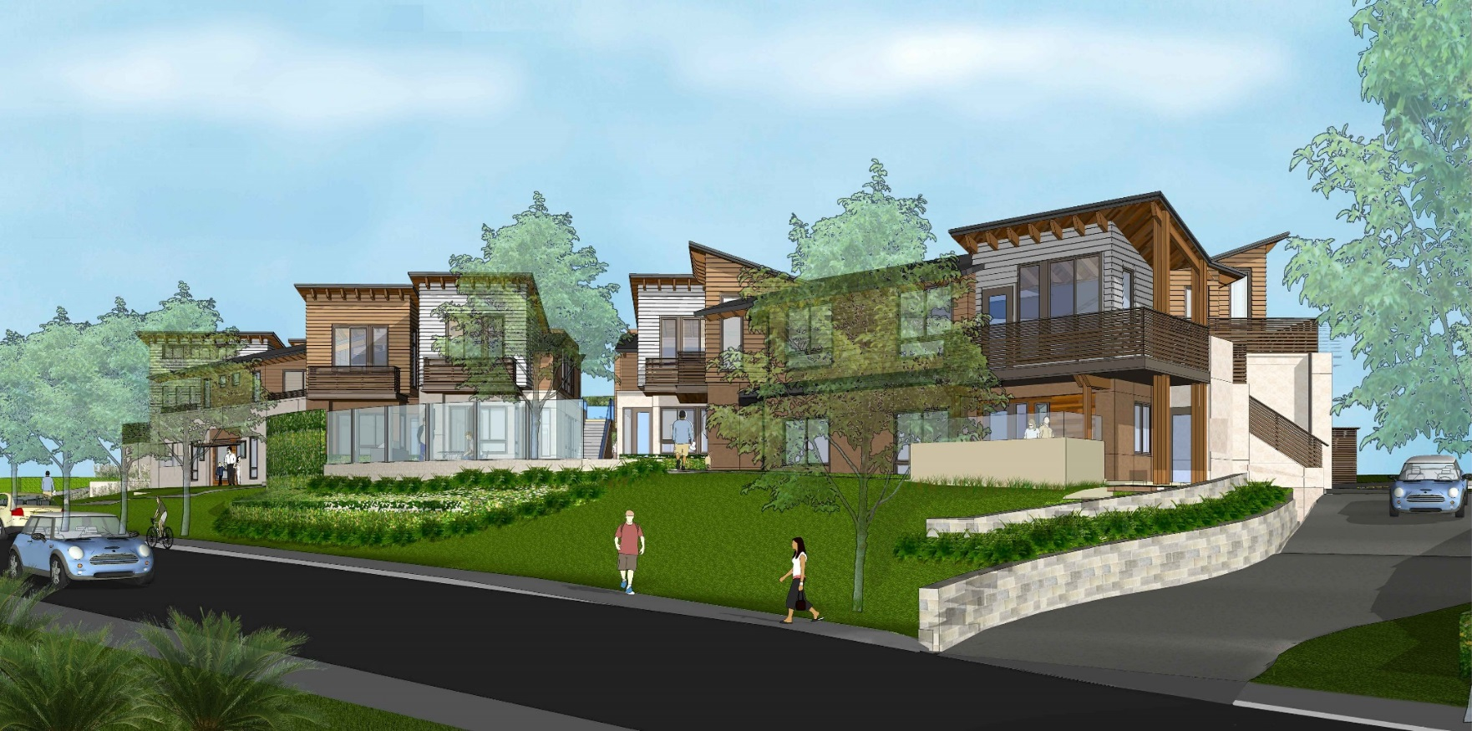
Foothill Apartments
  15 apartments units on an existing vacant lot

Slide 9
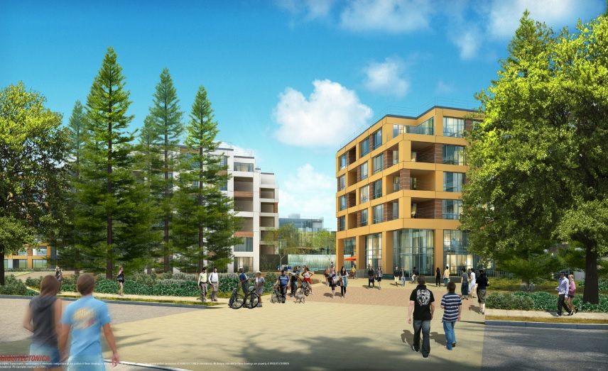
The Hamptons
  Replace 342 apartments units with 942 apartment units (600 net new)
Notes:
Replace 342 apartment units with 942 apartment units

Slide 10
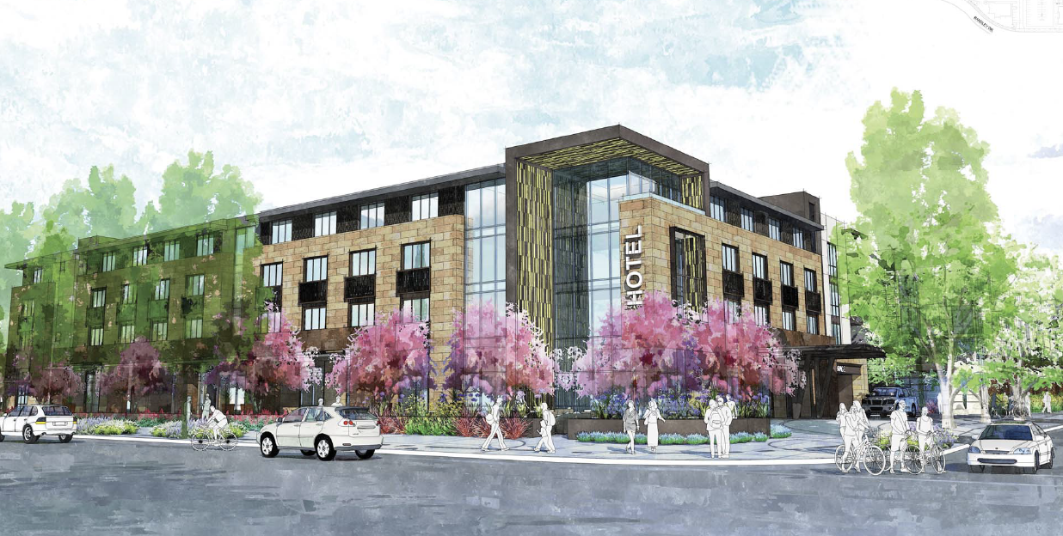
Marina Plaza
  188 apartments units, with a 122 full-service hotel, and approximately 22,600 sq. ft. of retail
Notes:
188 apartment units, with approximately 22,600 s.f. of retail, and a 122 room hotel

Slide 11
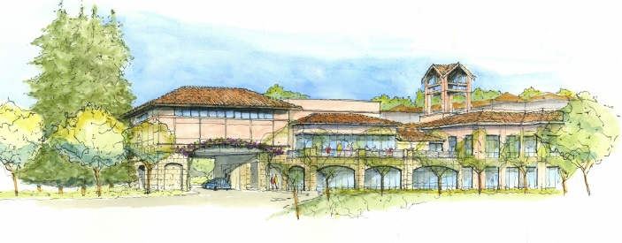
The Forum
  Proposed additions and renovation to an existing retirement care facility
  Includes 25 new independent living villas, 36 beds, 39,755 sq. ft. of renovation, 43,017 sq. ft. of new additions
Notes:
allow additions and renovations to the existing care retirement facility
Including 25 new independent living villas, 36 beds, 39,755 sq. ft. of renovation, 43,017 sq. ft. of new additions, and 95,336 sq. ft. of new buildings.

Slide 12
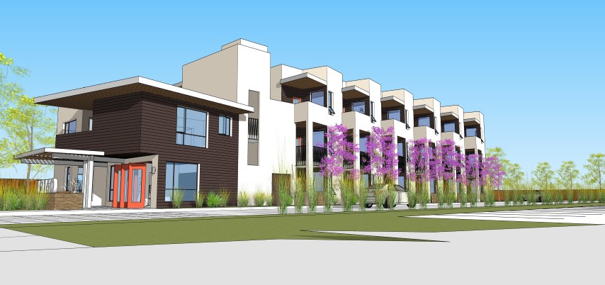
Veranda
  19 unit affordable senior citizen housing development
Notes:
19 unit affordable senior citizen housing development

Slide 13
Participate in the
Vallco Specific Plan
Subscribe to e-notification on www.cupertino.org and select “Vallco”
Check out the new website launching soon: www.envisionvallco.org
Save the date of upcoming design workshops (aka “charrettes”)
  April 9-13 and May 21-25 at City Hall

Slide 14
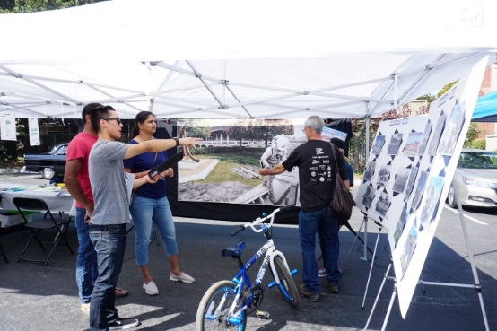
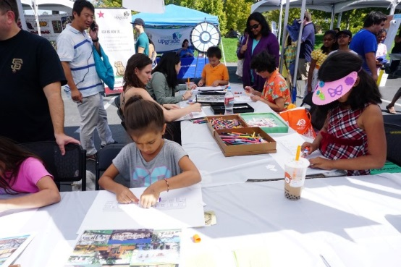
Participate in the
Vallco Specific Plan
Planners are on tour! Look out for us at the Creekside Farmer’s Market on Friday mornings starting 2/16
Host a “civic dinner”
Dates and other locations TBD

Slide 15
Vallco Specific Plan

Slide 16
Community Interviews
We are looking for seven (7) volunteers to participate in group community interviews
Must be available on February 6th at 6:00pm
Sign up with Planning Department
  Participants will be randomly selected from the sign up sheet
Notes:
6:00 February 6th at A-loft
Particpate in community stakeholder interviews
Seven volunteers

