Slide 1
Block Leader Meeting
Application Division Update
Nidhi Mathur

Slide 2
New City Website
New website and content management launched in May 2017
User friendly design with emphasis on easy access and navigation
Contents divided in Residents, Business and Visitors sections
Most visited pages like Agenda, Code, Recreation and Permits linked from home page
Positive feedback from community members

Slide 3
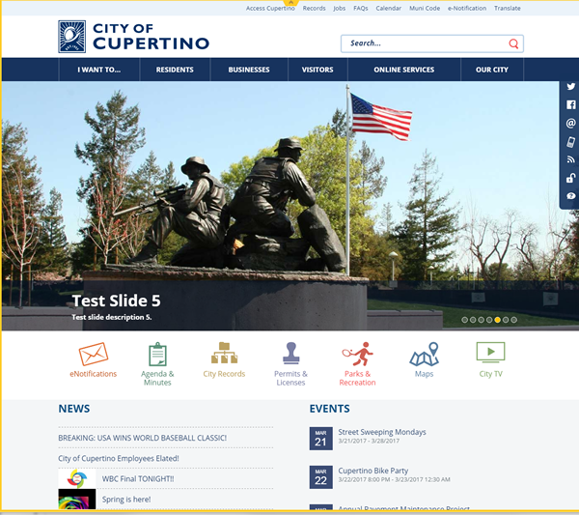
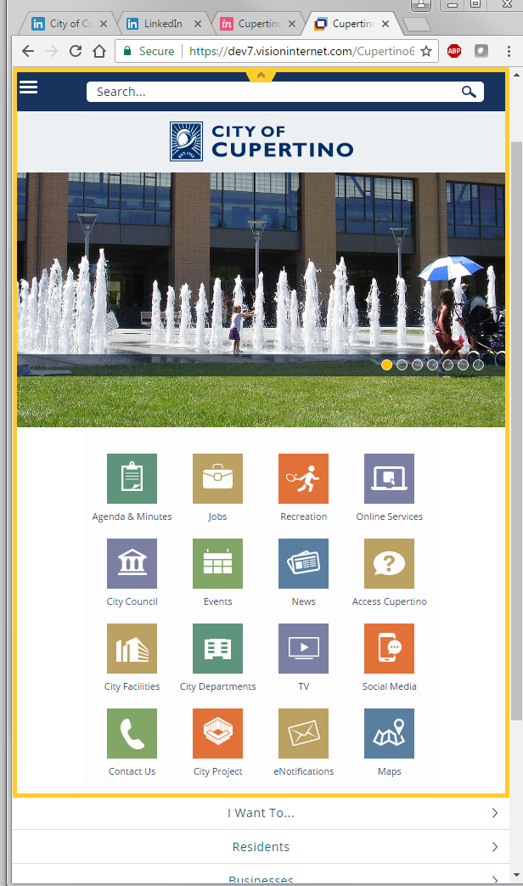
Mobile & Responsive Design

Slide 4
Open Data Portal
In spirit of transparency and open government Cupertino has its open data portal at: data.cupertino.org
  Open Gov – Cupertino financial and budget
  Junar – data on city’s infrastructure and demographics data
  GIS portal – development, property, transportation & recreation data

Slide 5
Land Use Application
Cupertino went paperless with the launch of its land use management system
  Residents and contractors can submit digital permit applications
  City staff does plan checks digitally on a monitors instead of on large paper plans
  Cupertino is in process of implementing additional features like public portal in its new land use management system

Slide 6
Mobile Apps
Application division will be launching the updated and redesigned Ready 95014 app
  Learn to build the preparedness kit by playing a game
  Set your out of area contact list
  Set up reminders to check your preparedness kits
  ARK maps

