Slide 1
City Manager’s Office
City Clerk’s Office
Public Affairs Division
Sustainability Division
Notes:
Manages City operations
Execute Council Work Program and policy priorities

Slide 2
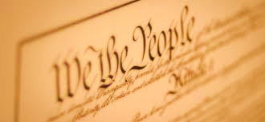
City Clerk’s Office
Build trust and confidence by promoting transparency, engaging the community, providing accessibility to local government and ensuring regulatory compliance.

Slide 3
City Clerk’s Office
Primary Responsibilities
  Manage municipal elections
  Manage records for the City
  Keep track of City Council legislative actions
  Facilitate Commission Interviews
  Publish Legal Notices
  Community services
    Notary Public (subject to State fee)
    Block Leaders can make copies of flyers for free

Slide 4
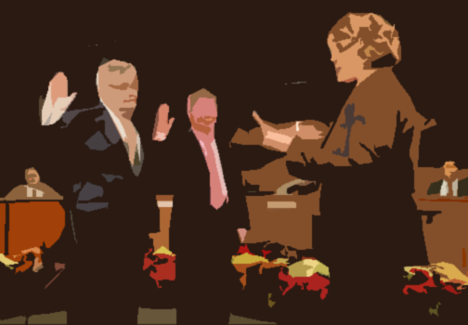
Get Involved
Run for City Council
Apply for a Commission
Contact:
City Clerk Grace Schmidt
cityclerk@cupertino.org
408-777-3223

Slide 5

Public Affairs
Gives Cupertino residents access to timely, engaging, and important information about City services, initiatives, and programs.

Slide 6



Public Affairs
The Cupertino Scene
Website
Social Media: @cityofcupertino
AlertSCC (www.alertscc.com)
Notes:
The Scene (Every month but August and January)
Website (The front page news is updated daily with new information on services, programs, events, and project updates
Site is now mobile friendly and can be viewed and navigated easily on smartphones and tablets
Social Media: Nextdoor, Facebook (www.facebook.com/cityofcupertino), Twitter (www.twitter.com/cityofcupertino, or @cityofcupertino)
AlertSCC (Sign up at www.alertscc.com, or download the app in the app store)
Work closely with public safety when emergency situations arise

Slide 7
Upcoming Events
State of the City – January 31st
CREST Awards
  Lifetime Achievement Award (Volunteer)
  Individual Volunteer of the Year
  Volunteer Organization of the Year
  Rising Star Award (Volunteer)
  Innovator of the Year (Technology)
  Public Safety Person of the Year
  Sustainability Champion of the Year
Notes:
State of the City: Wednesday, January 31 at Quinlan
11:30 a.m. and then 6:30 p.m.
CREST Awards: New categories, visit www.cupertino.org/crest

Slide 8



Sustainability
  Reduced Greenhouse Gas emissions 13% since 2010
CARBON FREE ELECTRICITY
Notes:
Sustainability Oversees Climate Action Plan
Defines strategies to reduce greenhouse gas emissions
Provides residents, businesses and schools with programs and services focused on energy efficiency, renewable energy, water conservation, alternative transportation and other sustainable actions.
Since 2015, the City has reduced Greenhouse gas emissions 13%.
One thing to let you know about is Silicon Valley Clean Energy- The default electricity provider which provides carbon free electricity for all residents and businesses in the City

Slide 9


Sustainability
Rebates from Santa Clara Valley Water District
  Greywater: $400 for the install of qualifying Laundry to Landscape systems.
  Ditch the Lawn!: $2 per square foot rebate for lawn conversions.
Visit one of 50 Certified Green Business
  www.cupertino.org/greenbusiness
Notes:
What might be of interest to this group is water rebates available from the Santa Clara Valley Water District
Greywater: $400 for the install of qualifying Laundry to Landscape systems.
Ditch the Lawn!: $2 per square foot rebate for lawn conversions.
Green Businesses: Visit one of our 50 Green Businesses throughout the city
GreenBiz participants…
Conserve water, energy
Reduce pollution and waste
Access free support & equipment
Cut utility costs
Receive free marketing
Gain recognition from City & County

Slide 10
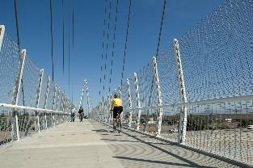
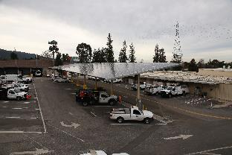

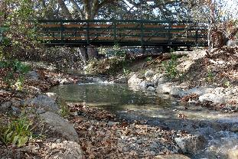
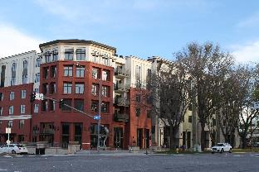
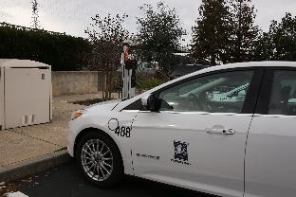
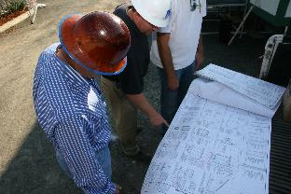
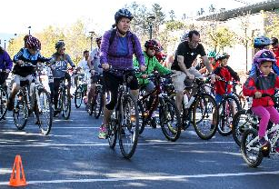
Sustainability
Misty Mersich
Sustainability Manager
mistym@Cupertino.org
Cupertino.org/Sustainability
Notes:
Thank you- contact information

