Slide 1
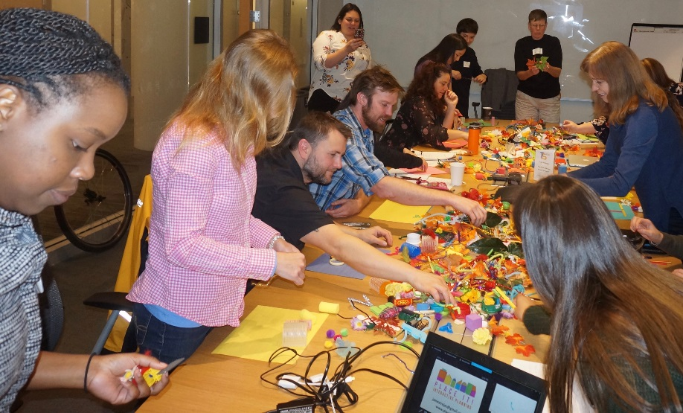
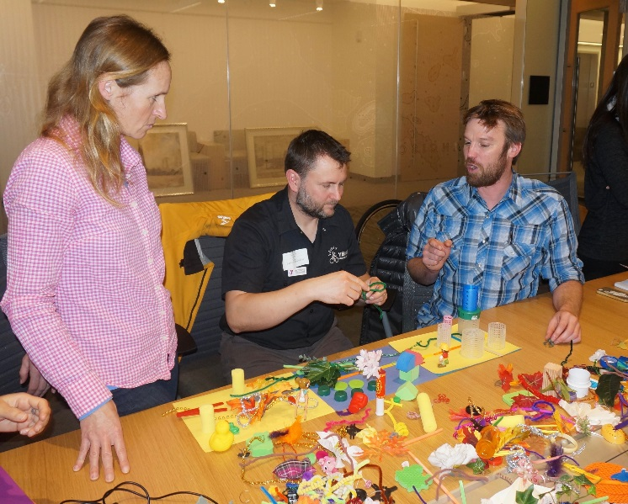
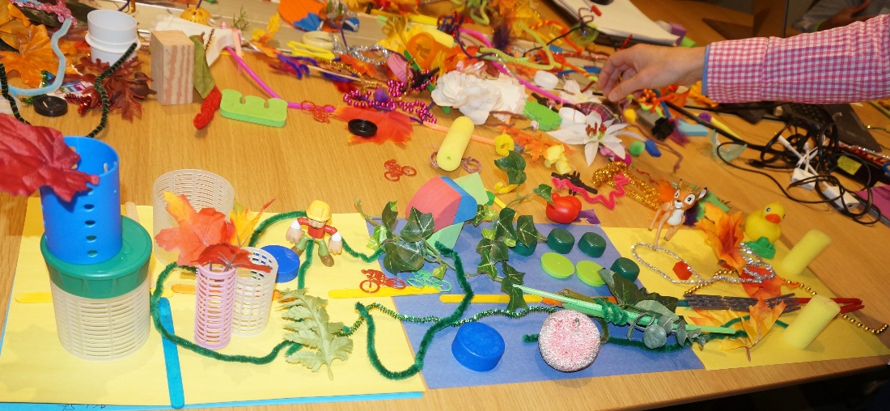
Cupertino SR2S Presents- “Building Safe Routes: Community Visioning Workshop”
March 13, 2018
Welcome! Please come in and have a seat at any table ☺
Notes:
This is part of our new PICH grant for the 2016/17 school year

Slide 2
March Theme: Envision
Please introduce yourselves to the group with:
Your Name
What is one possibility you envision for the future of Cupertino transportation?

Slide 3
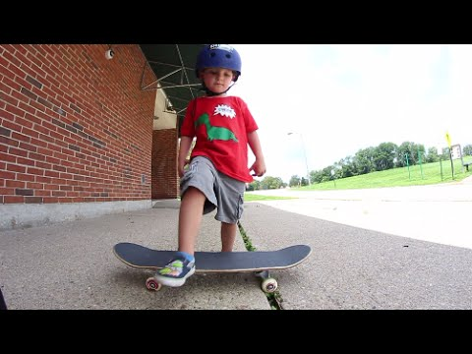
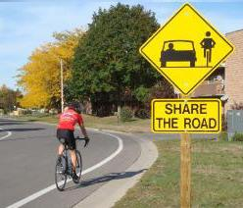
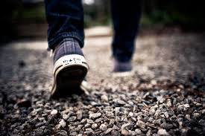
Cupertino Safe Routes 2 School (SR2S)
Mission Statement: “Create a safer environment for students and families in Cupertino to travel to and from school actively.”
Notes:
Re-emphasize our mission statement

Slide 4
SR2S: What are we doing here?
Safe Routes to School: “sustained efforts by parents, schools, community leaders and local, state, and federal governments to improve the health and well-being of children by enabling and encouraging them to walk and bicycle to school.”
We are: an active working group coming together to prioritize campus and adjacent roadway/sidewalk/school site programs in order to make the above happen. This includes engineering, enforcement, education, evaluation, encouragement, and equity.
Our meetings are: Venues for SR2S group members (that’s us) to meet, choose projects to advance our mission, and move them along at different school sites, district-wide, or City-wide.
Notes:
Welcome to new members! Can you please introduce yourselves? Introduce Sam.

Slide 5
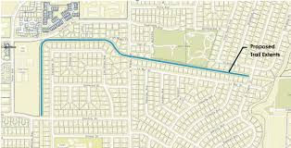
Project Updates: Regnart Creek Trail Project
Next Meeting: Monday April 23rd, from 6:30 - 8PM in Community Hall www.Cupertino.org/bikeplan
Meeting Purpose: To introduce concept plans. These concepts have been driven by feedback received from community meetings and discussions with Santa Clara Valley Water District
Action: Please advertise to your neighborhoods and school communities to attend the meeting (flyer coming soon!) ☺
Notes:
This is part of our new PICH grant for the 2016/17 school year

Slide 6
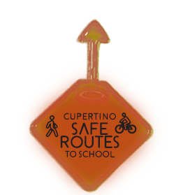
Project Updates: Reflective Bag Tags
What? Reflective tags for backpacks, bikes, clothes, etc.
Why? These tags increase visibility. They can be used as a give-away for a walk and roll day or other school event.
Who? We have 200 tags for each elementary school
How? If you represent an elementary school and want tags to use for a program, please ask us!
Notes:
This is part of our new PICH grant for the 2016/17 school year

Slide 7
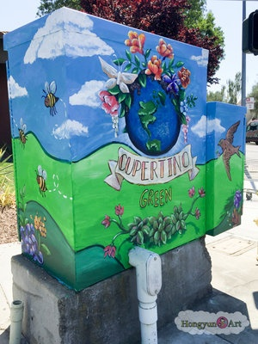
Project Updates: “Energized By Art” Utility Box Project
This Year’s Theme: How do you get around Cupertino in the greenest, safest way possible for you? (i.e. public transit, carpooling, walking, biking, alternative fuel vehicles)
What: K-12 art design contest to illustrate our City’s
Utility Boxes
When: Submissions due in-person by 5 PM on
April 9th, 2018
Who: Any K-12 student who attends school in Cupertino
For More Information Visit: http://www.cupertino.org/our-city/departments/environment-sustainability/green-events-activities/utility-box-art
Notes:
This is part of our new PICH grant for the 2016/17 school year

Slide 8
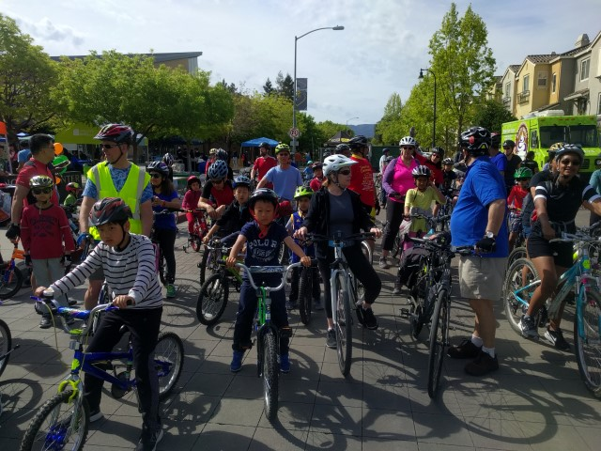
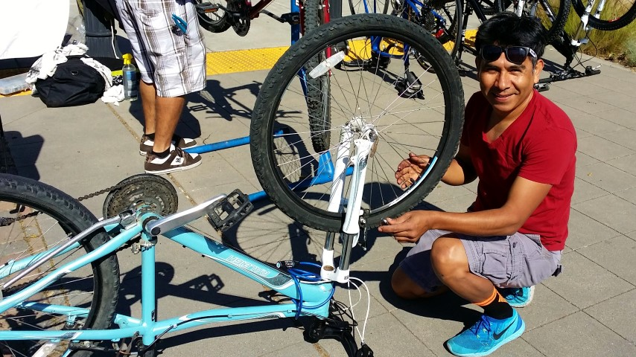
Event Updates: 2018 ‘Pedal 4 the Planet’ Rides!
What: Family bike rides to celebrate Safe Routes 2 School and Earth Day!
Details: Two separate routes running concurrently, starting and ending at the Cupertino Earth Day Festival (at City Hall)
Route Lengths: 5.6 miles; 10.5 miles
When: Saturday, April 21st at 10 AM (please arrive at 9 AM to sign waivers and eat snacks/hydrate)
Who: Anyone is welcome to join the ride! Kids under 14 need ride chaperone
Other Things: Free bike repairs, free bike valet!
Notes:
This is part of our new PICH grant for the 2016/17 school year

Slide 9
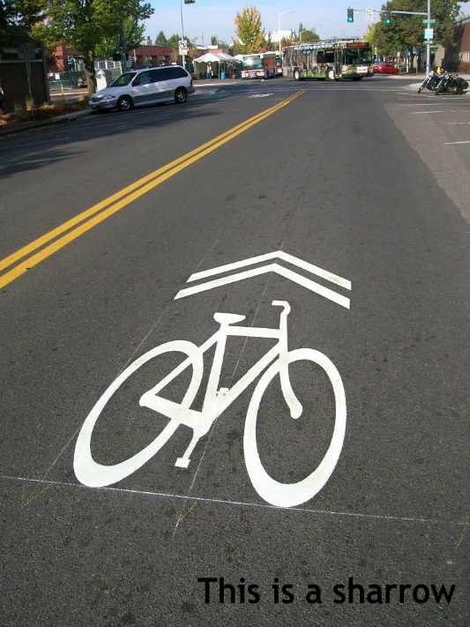
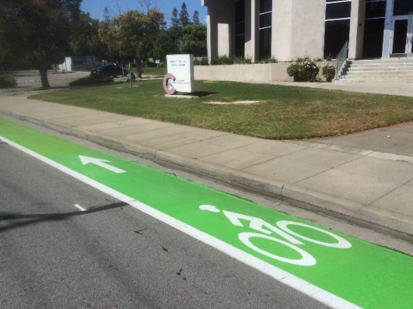
FAQ from the Frontlines
David Stillman, Transportation Manager, City of Cupertino
Notes:
This is the time in our meeting to speak with a civil engineer. Today we have David Stillman who is here to answer any of the group’s questions. Walk Audit projects. Upcoming pedestrian plan.

Slide 10
Presenting: Special Guest James Rojas!
Community Visioning Workshop

Slide 11
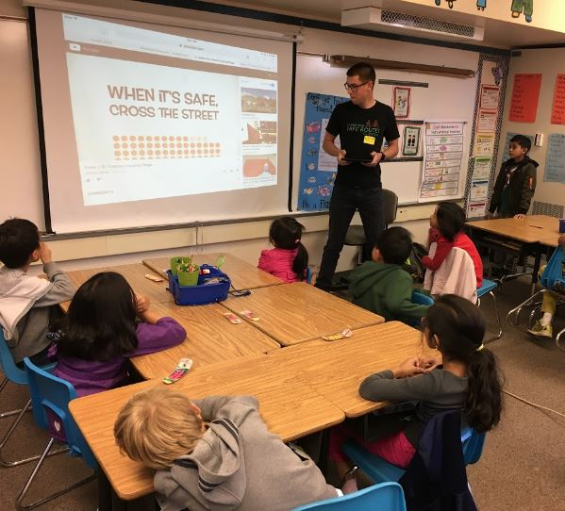
Upcoming Events
Tuesday, April 3rd (7:30 AM – 12:30 PM @ Quinlan Community Center)
Smart Cycling Bicycle Education Class- register here
Wednesday, April 11th (4-5 PM @ Conference Room C)
SR2S Working Group Meeting
Saturday, April 21st (approximately 10 AM – 3 PM @ City Hall)
Pedal 4 the Planet Family Bike Rides and Earth Day Festival!!!!
Monday, April 23rd (6:30 – 8 PM @ Community Hall)
Regnart Creek Trail Community Feedback Meeting
Wednesday, May 9th (all day)
National Bike to School Day!

Slide 12
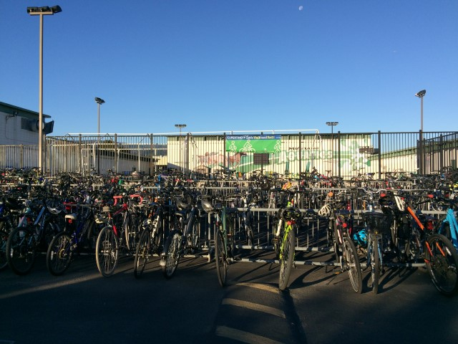
Reminders: Bike Counts
What? Bicycle counts conducted at every school twice per month
Why? Additional source of bicycling data
Who? Chelsea, Matt, school staff, student volunteers
When? Jan – June 2018
Reminder: Continue submitting bike count data
Every month! ☺
Notes:
This is part of our new PICH grant for the 2016/17 school year

Slide 13
Reminders: Action Items
Provide Feedback!
Please let us know what you thought of this workshop by clicking here or emailing Chelseab@Cupertino.org

Slide 14
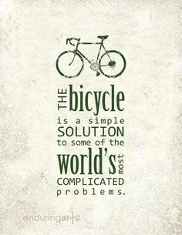
Thank You!
Have any additional feedback to share?
Email: saferoutes@cupertino.org
Website: cupertino.org/saferoutes
Notes:
Thank you all for coming. I will be sending a meeting debrief email in the near future with all meeting resources and information. The meeting powerpoint and agenda will be posted on our Safe Routes webpage.

