Slide 1
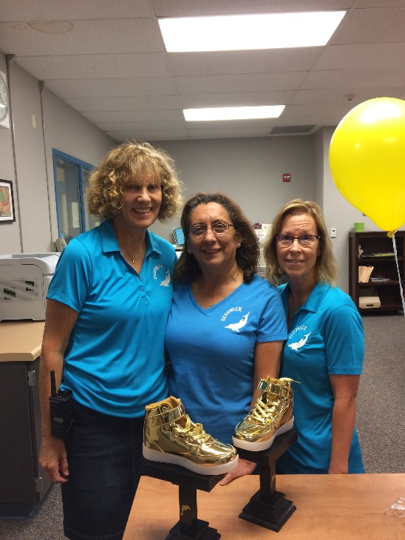
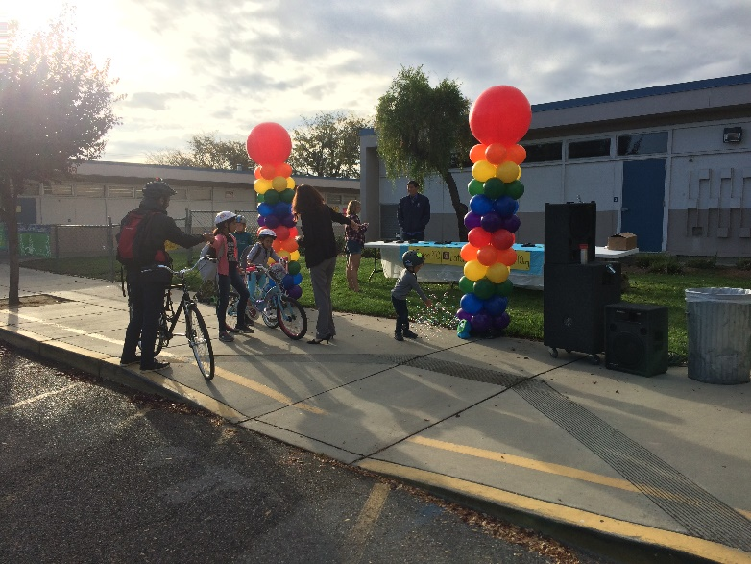
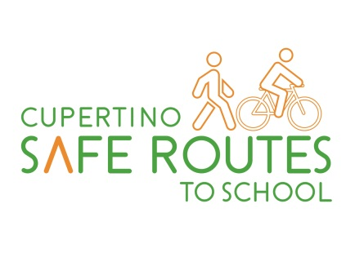
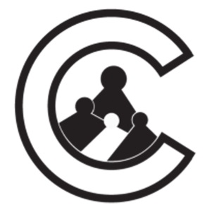
Cupertino SafeRoutes2School Moving beyond improving infrastructure to change behavior
Oct 24th , 2018
Working Group Meeting

Slide 2
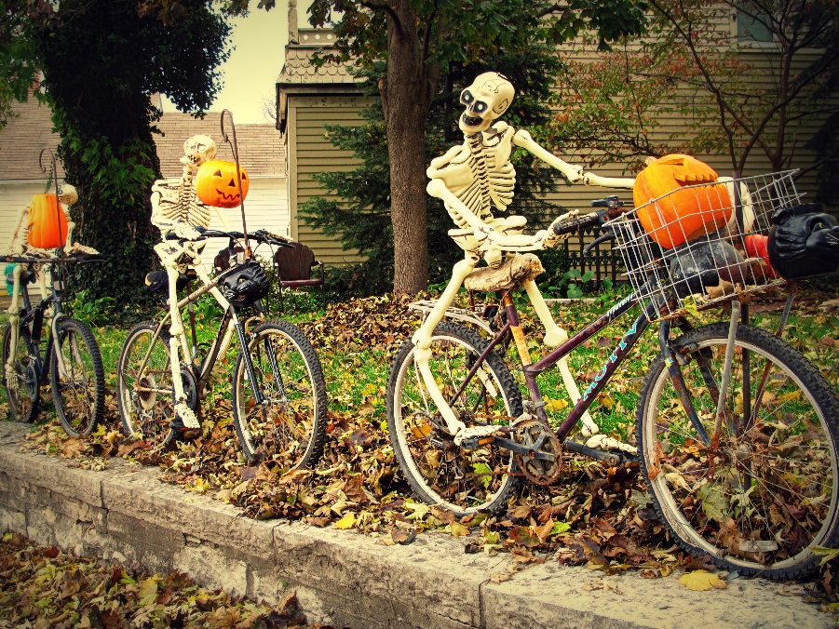
Cupertino SR2S: Welcome Fall!
Please introduce yourselves to the group with:
Your Name
Your school or org.
If you have a bike, what kind is it?
Notes:
Have all members introduce themselves- especially new members

Slide 3
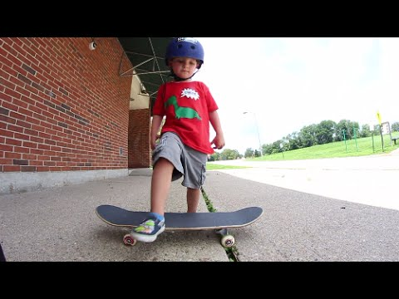
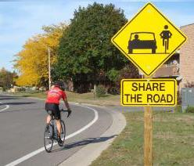
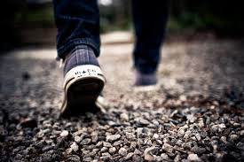
Cupertino Safe Routes 2 School (SR2S)
Mission Statement: “Create a safer environment for students and families in Cupertino to travel to and from school actively.”
Notes:
Re-emphasize our mission statement

Slide 4
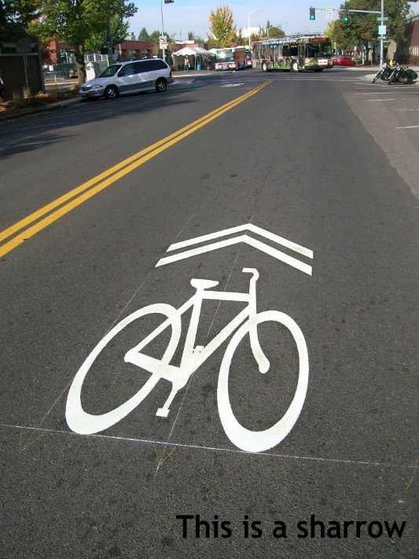
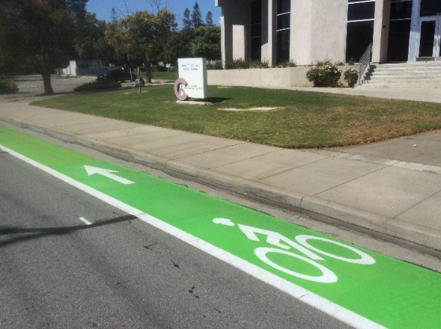
‘FAQ’ from the Frontlines
David Stillman, Transportation Manager, City of Cupertino
Notes:
This is the time in our meeting to speak with a civil engineer. Today we have David Stillman who is here to answer any of the group’s questions.

Slide 5
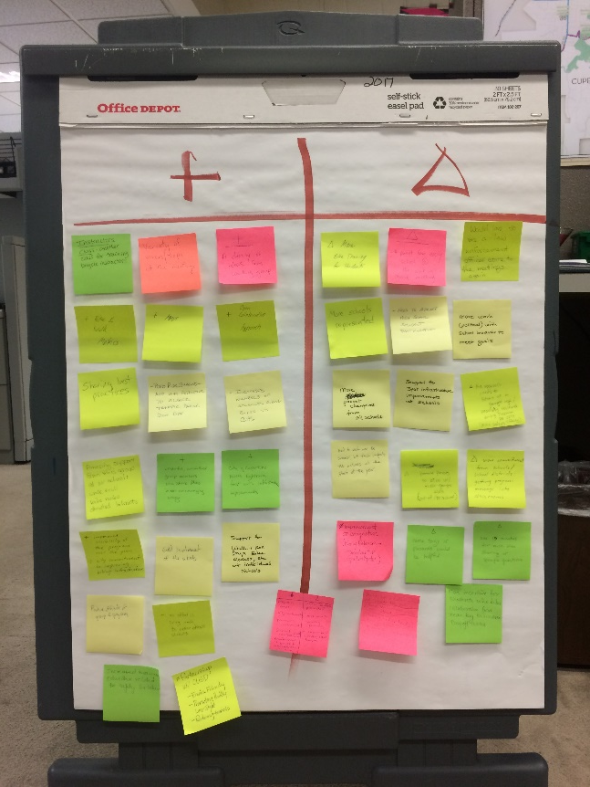
Discussion Item: Plus/Delta Results
+
What’s positive about the program?
What do you want to see continue?
What needs changing?
What could be improved?

Slide 6
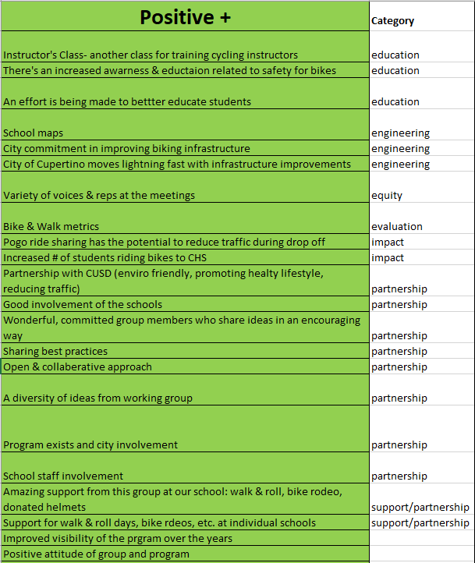
Discussion Item: Plus/Delta Results
+

Slide 7
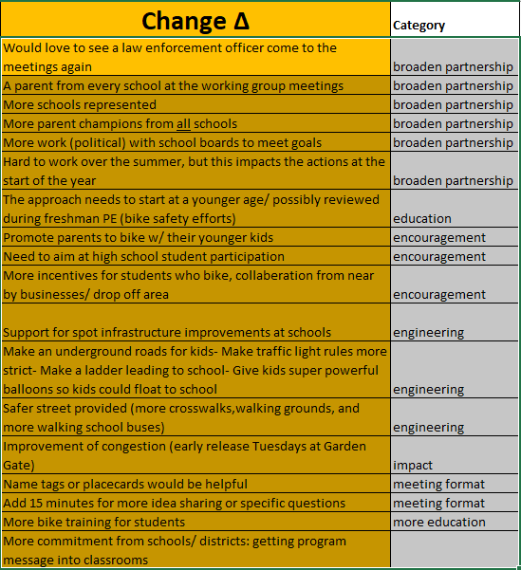
Discussion Item: Plus/Delta Results

Slide 8
Discussion Item: Model Safe Routes to School Program: Palo Alto
6 Es:
Notes:
Like Cupertino’s program, Palo Alto’s is built on a set of E’s.

Slide 9
Discussion Item: Model Safe Routes to School Program: Palo Alto
6 Es:
Engineering
Notes:
Like Cupertino’s program, Palo Alto’s is built on a set of E’s.

Slide 10
Discussion Item: Model Safe Routes to School Program: Palo Alto
6 Es:
Engineering
Enforcement
Notes:
Like Cupertino’s program, Palo Alto’s is built on a set of E’s.

Slide 11
Discussion Item: Model Safe Routes to School Program: Palo Alto
6 Es:
Engineering
Enforcement
Education
Notes:
Like Cupertino’s program, Palo Alto’s is built on a set of E’s.

Slide 12
Discussion Item: Model Safe Routes to School Program: Palo Alto
6 Es:
Engineering
Enforcement
Education
Encouragement
Notes:
Like Cupertino’s program, Palo Alto’s is built on a set of E’s.

Slide 13
Discussion Item: Model Safe Routes to School Program: Palo Alto
6 Es:
Engineering
Enforcement
Education
Encouragement
Evaluation
Notes:
Like Cupertino’s program, Palo Alto’s is built on a set of E’s.

Slide 14
Discussion Item: Model Safe Routes to School Program: Palo Alto
6 Es:
Engineering
Enforcement
Education
Encouragement
Evaluation
Equity
Notes:
Like Cupertino’s program, Palo Alto’s is built on a set of E’s.

Slide 15
Discussion Item: Model Safe Routes to School Program: Palo Alto
6 Es:
Engineering
Enforcement
Education
Encouragement
Evaluation
Equity
Notes:
Walk audits → infrastructure improvement recommendations and Walk and Roll map with suggested routes to school for each school.
Palo Alto did their walk audits long ago, so most of their recommendations have been implemented. In addition to those improvements, their bike network includes robustly traffic-calmed and tree-lined bike boulevards through neighborhoods, bike paths, bike lanes, protected bike lanes, sharrows. Palo Alto is also known for experimenting with untraditional or new kinds of infrastructure such as green lanes, bike boxes and roundabouts.

Slide 16
Discussion Item: Model Safe Routes to School Program: Palo Alto
6 Es:
Engineering
Enforcement
Education
Encouragement
Evaluation
Equity
Notes:
A member of the Palo Alto police attends most of their partnership meetings to give a traffic report on any collisions involving bikes or pedestrians. Outside of the meetings, they work together to determine whether infrastructure was a contributing factor to any bike/ped incidents, and determine whether any improvements could be made to make the area safer.

Slide 17
Discussion Item: Model Safe Routes to School Program: Palo Alto
6 Es:
Engineering
Enforcement
Education
Encouragement
Evaluation
Equity
Notes:
Education is the backbone of Palo Alto’s program. It is standardized across all schools. One advantage they have is that the Palo Alto Unified School District is the only district in the city, and it includes grades K – 12. All students in the district receive this education:
2nd grade –pedestrian education: assembly by Safe Moves
3rd grade – in-depth bike skills training : 2 in-class presentations followed by a super structured 1-hour bike rodeo for the entire 3rd grade. The rodeo consists of 6 or 7 stations: helmet bit, driveways, shoulder check/hazard avoidance, turn signals, uncontrolled intersection, stopped intersection, optional: bicycle maintenance: ABC quick check
5th grade – in-class bike refresher presentation given by a League certified bicycle instructor
6th grade – info at 6th Grade Orientation during first few days of school: rules of the road reminder, how to use any special infrastructure near the school, campus tour to see where the bike racks are
8th grade – Getting to High School event a couple weeks or months before middle school graduation to get soon-to-be high schoolers thinking about how they are going to get themselves to high school next year
Presentation: rules of the road, be predictable, how to make left turns, prepare for bad weather, bus/shuttle options, bike parking locations, school-specific bike perks such as bike clubs, bike repair station, cycling incentives, etc
Tables: 1) bike/walk route planning, 2) VTA routes, 3) safety quiz, 4) pizza if they complete 1-3
It has taken Palo Alto decades to hone their program, and they are constantly evaluating and trying new things. They typically pilot something at one school and if it works, they adopt it at all their schools. There are certainly pilots that flopped, and others that have been wildly successful, and they improve upon them every year.

Slide 18
Discussion Item: Model Safe Routes to School Program: Palo Alto
6 Es:
Engineering
Enforcement
Education
Encouragement
Evaluation
Equity
Notes:
Before School begins in the fall:
Police Department posts a blurb on NextDoor letting the community know what day school starts, encourages students to walk and bike, and reminds drivers to be careful of our youngsters.
Superintendent includes a blurb in her newsletter encouraging students to walk and bike.
Each middle and high school has a Back to School event where kids come get their picture. SRTS make the following presence at those events, to encourage kids to bring their bike to school BEFORE school ever begins.
- Bike repair (BikeMobile or VeloFix)
- Bike licensing historically, but Bike Indexing as of 2018 since bike licensing is no longer required in Palo Alto
- Helmet Fitting (Julie from Stanford)
- Route planning table (SR2S)
At the beginning of every school year:
- Community Bike Ride highlighting best family-friendly infrastructure: Bike Palo Alto
- Map for every new family: K, 6, 9, and other families new to the district
- Parent Orientation/Back to School Presentation: SRTS Slides telling parents about the walking/biking culture and tips on helmet fit
Ongoing:
Walk and Roll Days organized by school teams twice a year
Pedaling for Prizes at high school

Slide 19
Discussion Item: Model Safe Routes to School Program: Palo Alto
6 Es:
Engineering
Enforcement
Education
Encouragement
Evaluation
Equity
Notes:
Travel tallies are collected each year at all the schools, which informs how effective the program is: in 2017 there was an average rate of 78% of students who walked, biked, took a bus or shuttle, or carpooled.
After each educational event, the City conducted a survey to see what worked for the school and could be improved.

Slide 20
Discussion Item: Model Safe Routes to School Program: Palo Alto
6 Es:
Engineering
Enforcement
Education
Encouragement
Evaluation
Equity

Slide 21
Discussion Item: Model Safe Routes to School Program: Palo Alto
6 Es:
Engineering
Enforcement
Education
Encouragement
Evaluation
Equity
Notes:
This is not the only model, but it is one that works well for the community it serves.
To get to where they are, there has been a lot of trial and error.
Cupertino is still in its infancy and has done a LOT in the three years since the program got started. Some of their programming is solid, such as their bike safety presentations by the Safety Resource Officers, but for the most part, they are still in the pilot phase for a lot of their programming.
One of the things I am most excited about in my new role is to standardize the educational part of the program in all Cupertino schools, if there is partner support for that. However, I recognize that to standardize Cupertino schools would be an incomplete solution since the schools in Cupertino are only some of the schools in the Cupertino Union School District. So I hope to work with Sunnyvale, Los Altos and San Jose where possible, to take what is working at our schools and standardize it for all district schools.
It may look similar to what Palo Alto is doing, or we may find that something different would work better here – for example, maybe we want to break up the 6 stations of Palo Alto’s bike rodeo and offer them as a unit in our PE classes.

Slide 22
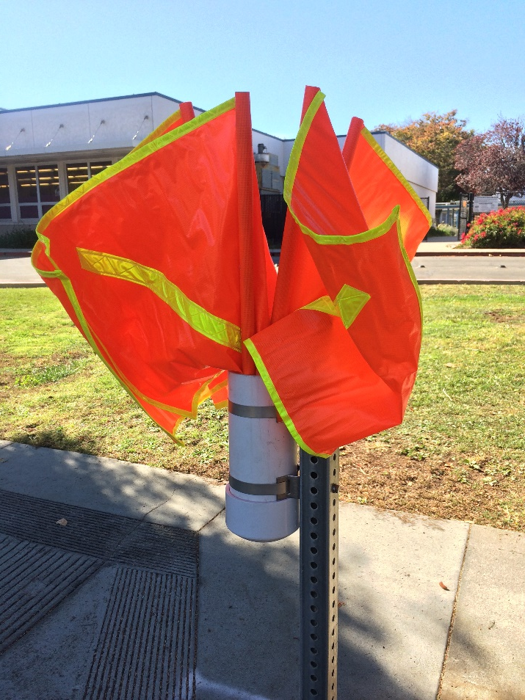
Discussion Item: Crossing Flags
Kennedy:
- Bubb and Pumpkin
Lawson:
Vista/Merritt
Apple Tree/Vista
Vista/Forest
Notes:
Matt recently had crossing flags installed at four intersections at two schools.
Kennedy: Bubb and Pumpkin
Lawson:
Vista/Forest
Vista/Apple Tree
Vista/Merritt

Slide 23
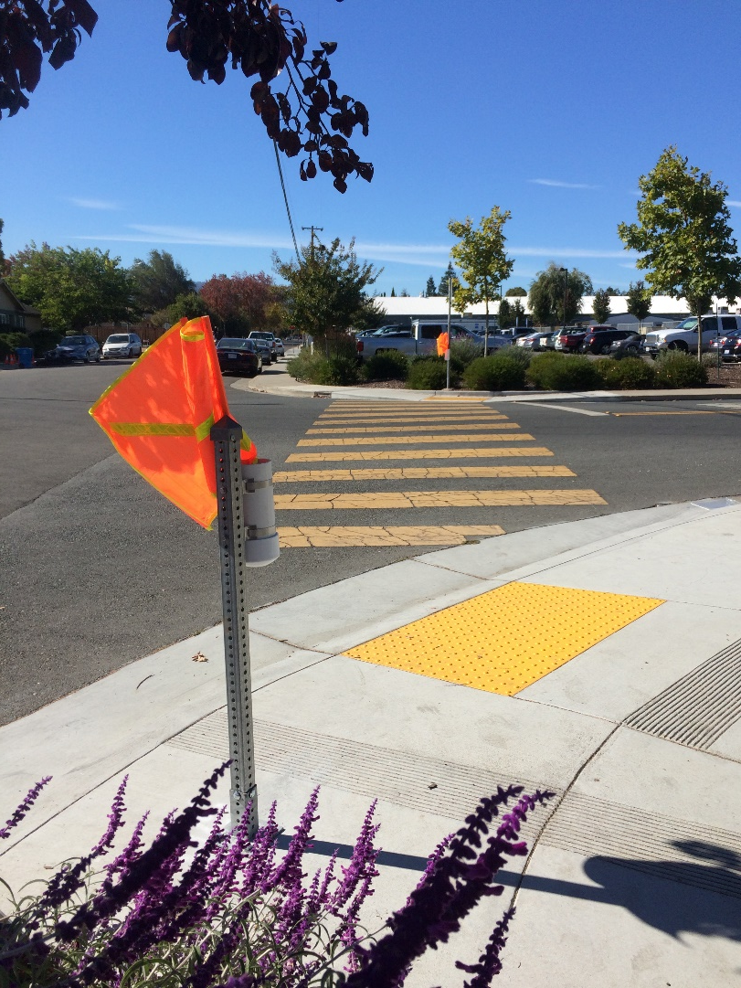
Discussion Item: Crossing Flags
Notes:
Matt recently had crossing flags installed at four intersections at two schools.
Kennedy: Bubb and Pumpkin
Lawson:
Vista/Forest
Vista/Apple Tree
Vista/Merritt

Slide 24
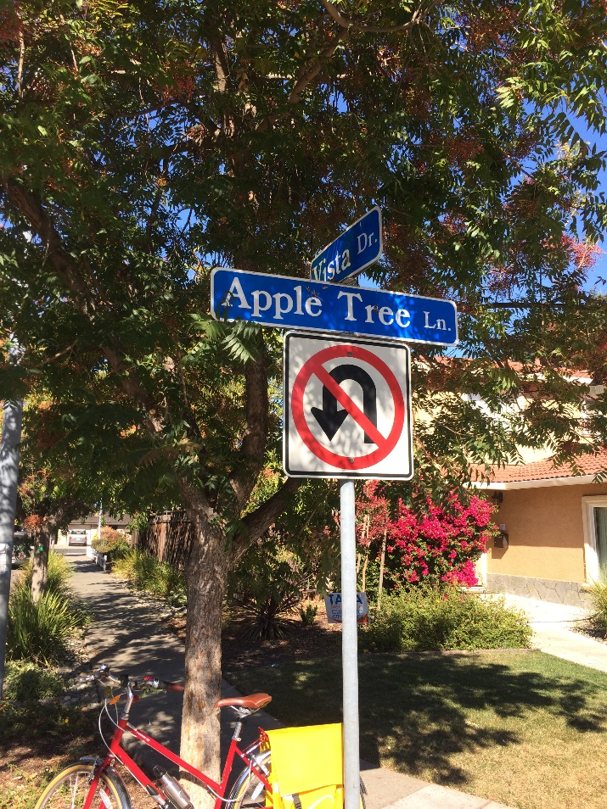
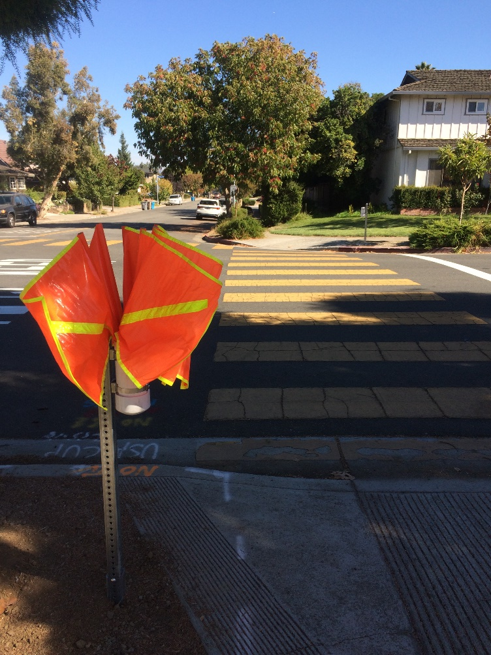
Discussion Item: Crossing Flags
Notes:
Matt recently had crossing flags installed at four intersections at two schools.
Kennedy: Bubb and Pumpkin
Lawson:
Vista/Forest
Vista/Apple Tree
Vista/Merritt

Slide 25
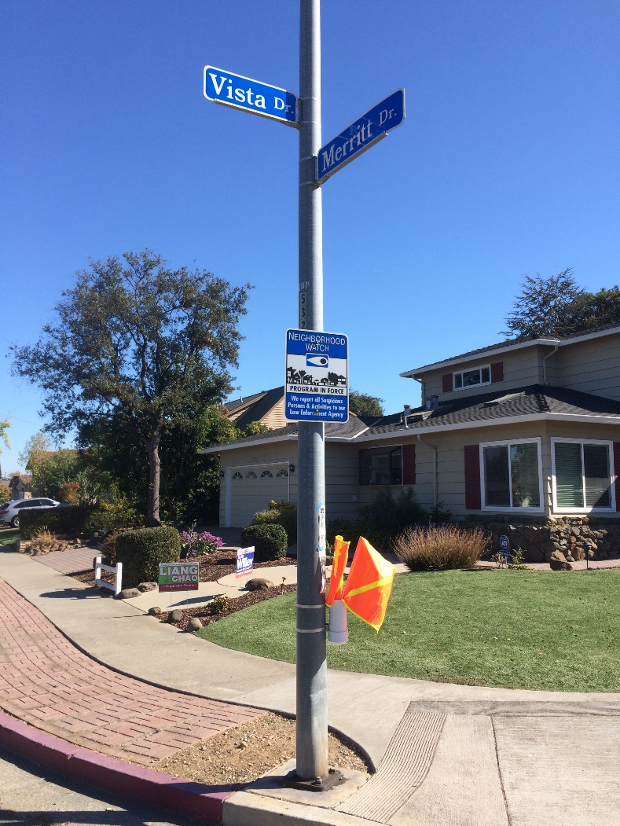
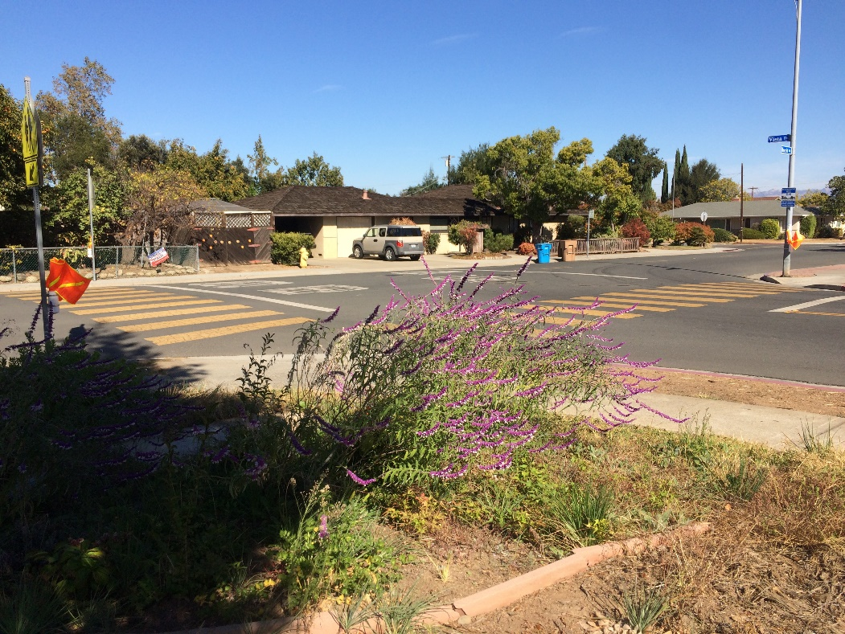
Discussion Item: Crossing Flags

Slide 26
Upcoming Events:
October 27th – Saturday: Fall Bike Fest! 9 AM – 12PM, City Hall Parking Lot
November 14th - Wednesday: Working Group Meeting, 4-5 PM, Conference Room C

Slide 27
Working Group Meeting Dates:
4-5 PM, Conference Room C
February 12th, 2019 (Tue)
March 13th, 2019 (Wed)
April 10th, 2019 (Wed)
May 21st, 2019 (Wed)
June 12th, 2019 (Wed)
September 25th, 2018 (Tue)
October 24th, 2018 (Wed)
November 14th, 2018 (Wed)
January 23rd, 2019 (Wed)

Slide 28
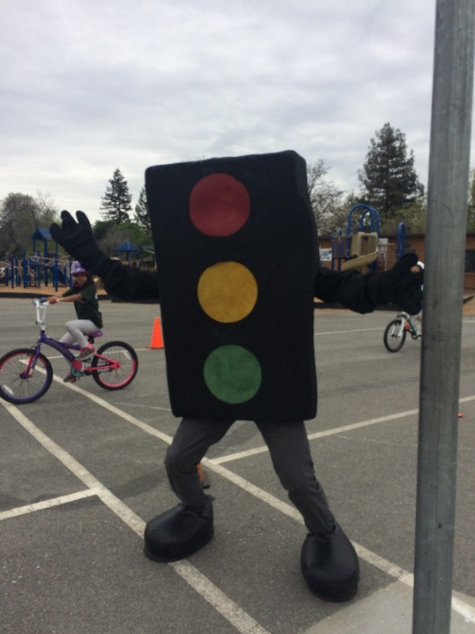
Reminders: Action Items
For schools:
Send rodeo requests to- saferoutes@Cupertino.org
High Schools- please help distribute the WG applications to students in the Fall
For everyone:
Best contact for program is saferoutes@Cupertino.org

Slide 29
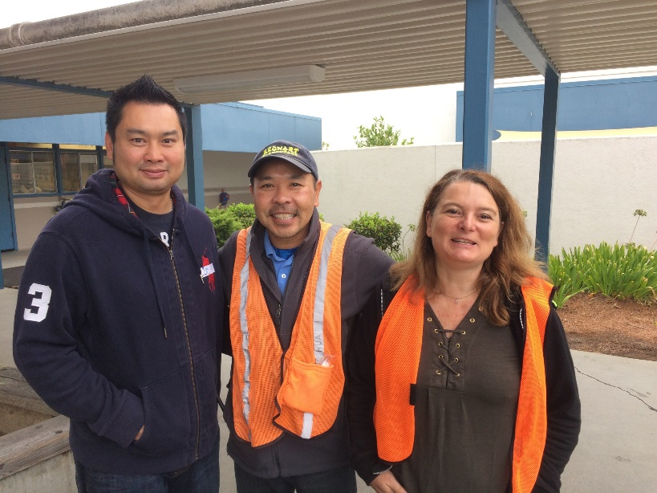
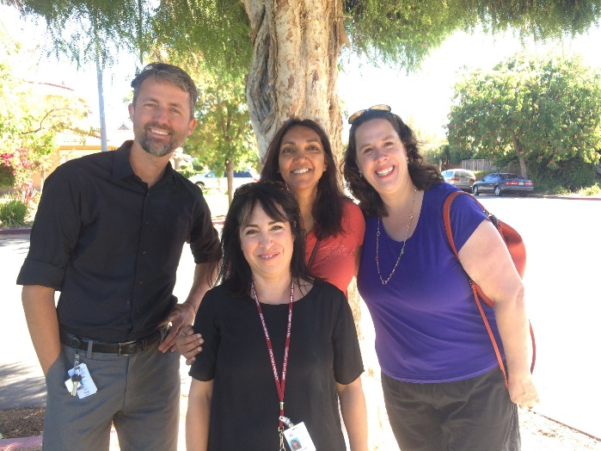
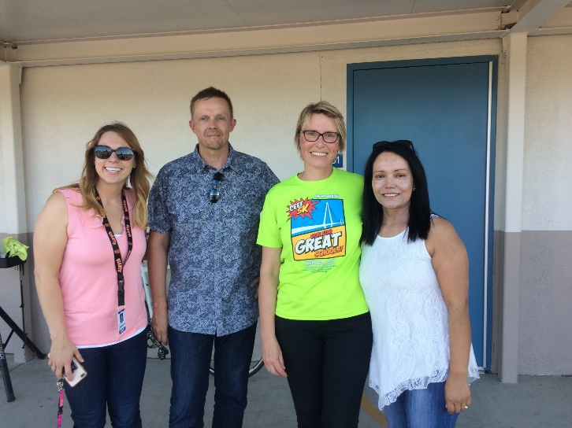
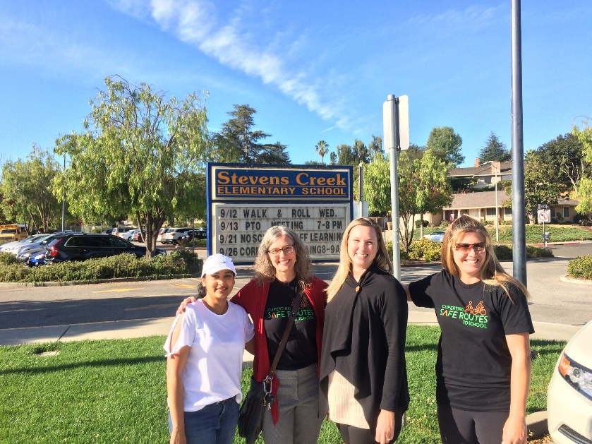
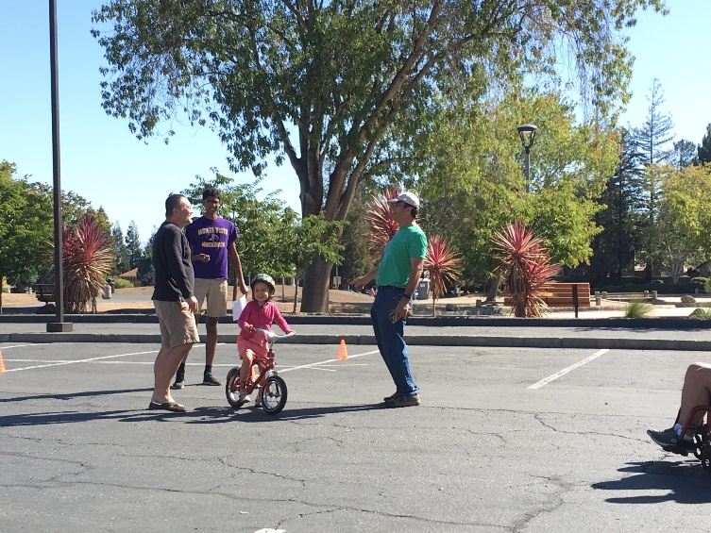
A Big THANK YOU!!
Notes:
Thank you all for coming.

