Slide 1
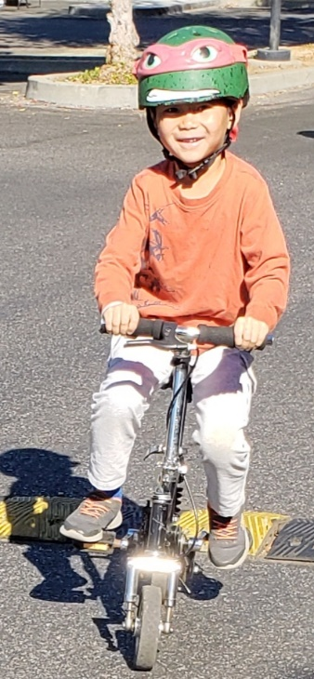
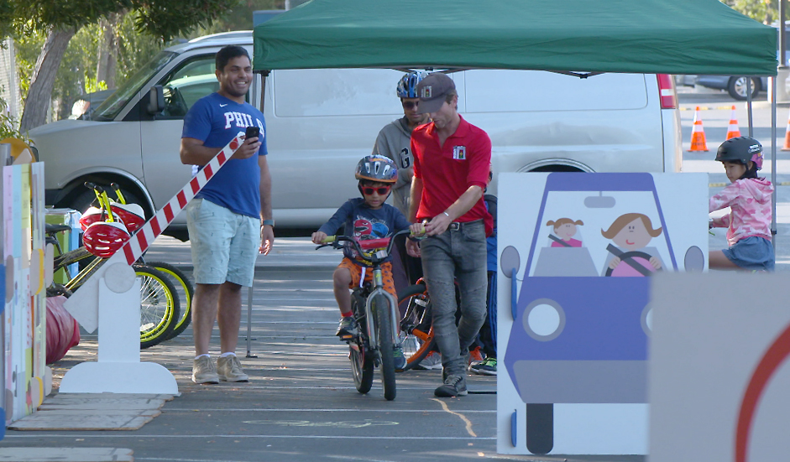
Cupertino SafeRoutes2School Moving beyond improving infrastructure to change behavior
Nov 14th , 2018
Working Group Meeting

Slide 2
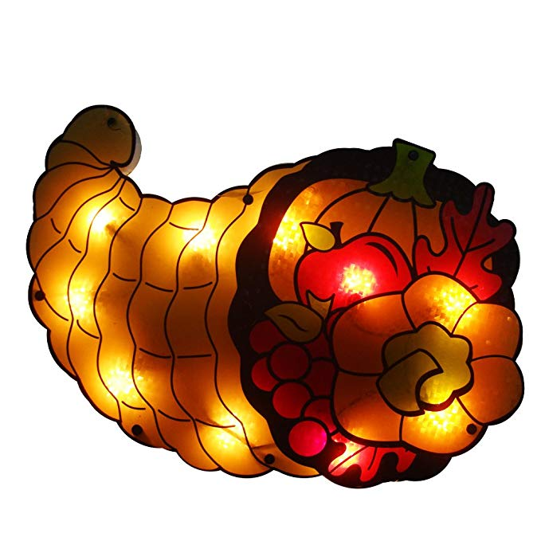
Cupertino SR2S: Thanks for your ideas!
Please introduce yourselves to the group with:
Your Name
Your school or org
What would draw you to Working Group meetings?
Notes:
Have all members introduce themselves- especially new members
As I put each agenda together for our Working Group meetings, I always strive to include items that are relevant and interesting to the group. I realize that what might be interesting to a parent or high school volunteer might be different that what a school or district staff member would want to discuss. So I would love to hear from you what types of discussions you would like to see on our agendas. Maybe it’s to hear what other schools are doing. Maybe you want a time to collaborate on new Safe Routes to School offerings.
Please introduce yourself to the group with…

Slide 3
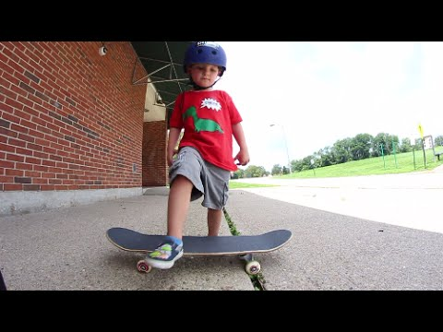
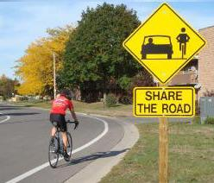
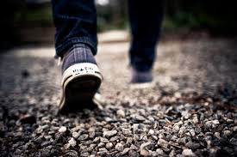
Cupertino Safe Routes 2 School (SR2S)
Mission Statement: “Create a safer environment for students and families in Cupertino to travel to and from school actively.”
Notes:
Re-emphasize our mission statement

Slide 4
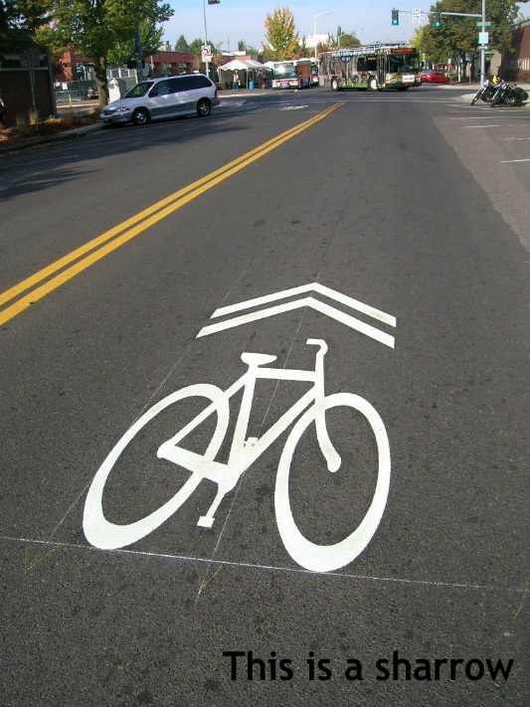
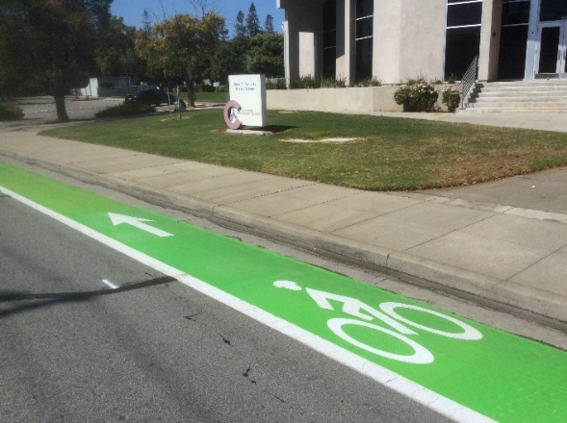
‘FAQ’ from the Frontlines
David Stillman, Transportation Manager, City of Cupertino
Notes:
This is the time in our meeting to speak with a Cupertino civil engineer. Today we have Transportation Manager David Stillman here to give us an update on City projects and to answer any of the group’s questions.

Slide 5
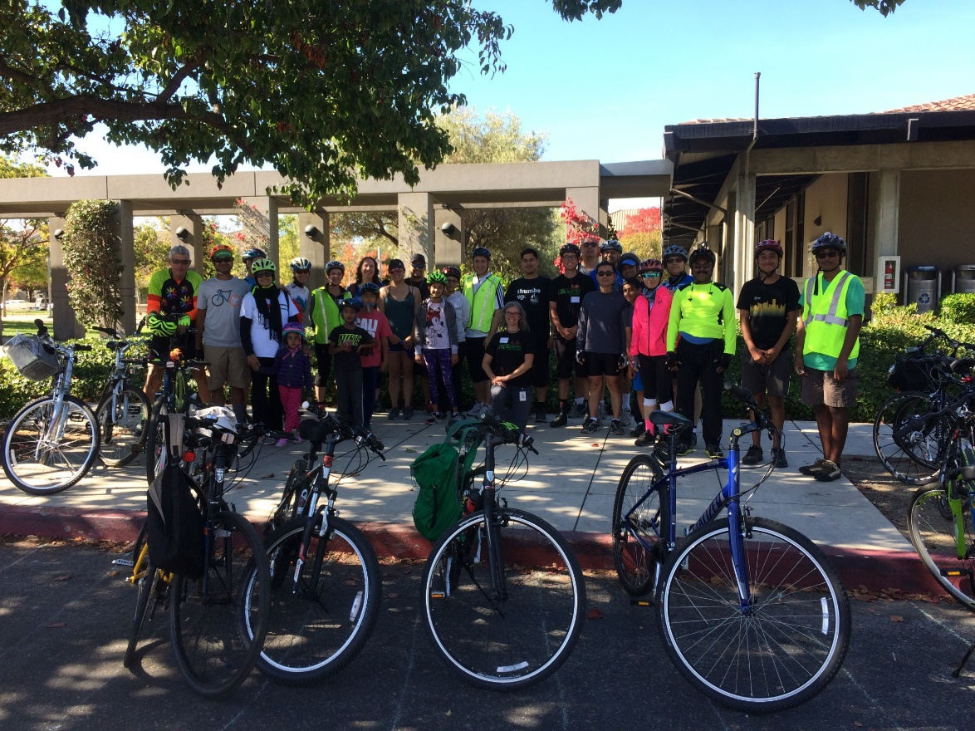
Presentation: October Highlights
Fall Bike Fest
Notes:
The Fall Bike Fest was a great success, thanks to all our partners:
Bicycle Pedestrian Commission: created the flyer, helped publicize, ran the registration booth and blender bike, led the bike rides, and helped clean up
Walk Bike Cupertino: helped advertise the event, and ensured a proper helmet fit for riders
High School Volunteers: helped setup, supervised bike parking, ran the snack table and bike decorating booth
Girl Scout Troop 60657: did face painting
Mike’s Bike’s: eBike demo
Calabazas Cyclery: bike tune-ups
Safe Moves: last but certainly not least - Bike Rodeo
Tacos el Rufles: lunch

Slide 6
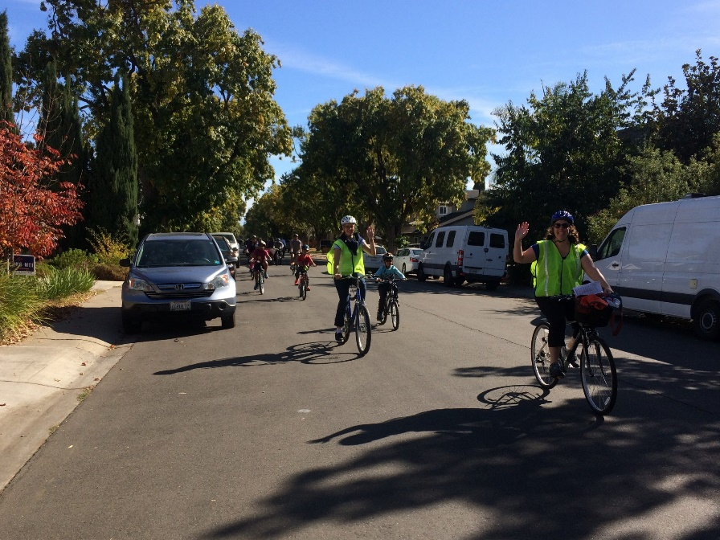
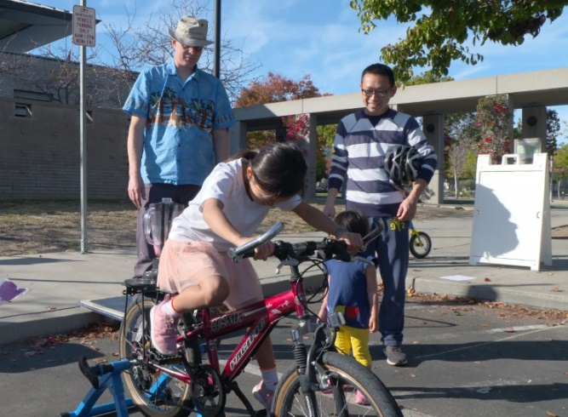
Presentation: October Highlights
Fall Bike Fest
BPC
Notes:
The Fall Bike Fest was a great success, thanks to all our partners:
Bicycle Pedestrian Commission: created the flyer, helped publicize, ran the registration booth and blender bike, led the bike rides, and helped clean up
Walk Bike Cupertino: helped advertise the event, and ensured a proper helmet fit for riders
High School Volunteers: helped setup, supervised bike parking, ran the snack table and bike decorating booth
Girl Scout Troop 60657: did face painting
Mike’s Bike’s: eBike demo
Calabazas Cyclery: bike tune-ups
Safe Moves: last but certainly not least - Bike Rodeo
Tacos el Rufles: lunch

Slide 7
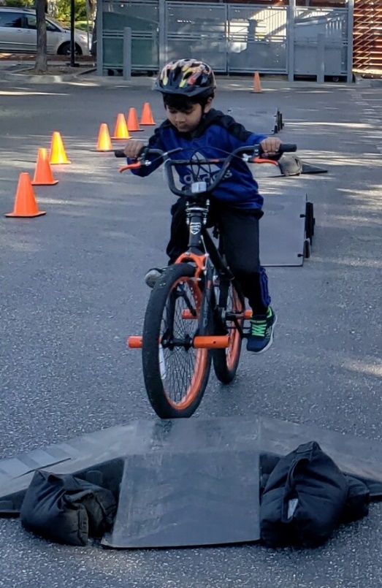
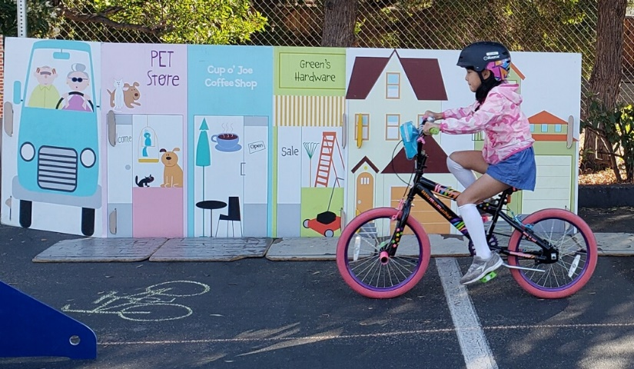
Presentation: October Highlights
Fall Bike Fest
Safe Moves
Notes:
The Fall Bike Fest was a great success, thanks to all our partners:
Bicycle Pedestrian Commission: created the flyer, helped publicize, ran the registration booth and blender bike, led the bike rides, and helped clean up
Walk Bike Cupertino: helped advertise the event, and ensured a proper helmet fit for riders
High School Volunteers: helped setup, supervised bike parking, ran the snack table and bike decorating booth
Girl Scout Troop 60657: did face painting
Mike’s Bike’s: eBike demo
Calabazas Cyclery: bike tune-ups
Safe Moves: last but certainly not least - Bike Rodeo
Tacos el Rufles: lunch

Slide 8
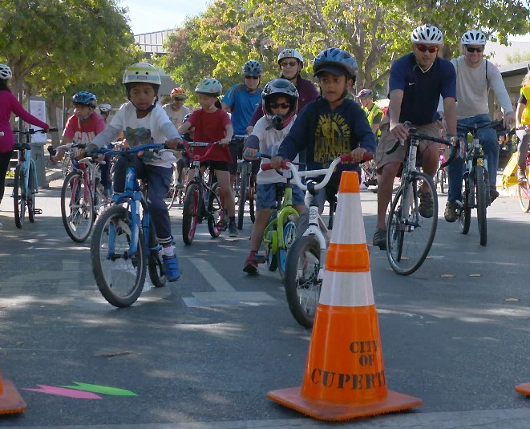
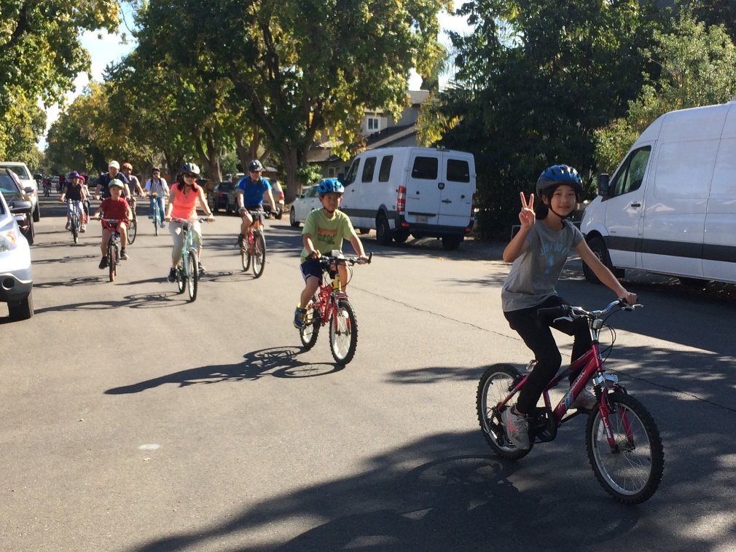
Presentation: October Highlights
Fall Bike Fest
Rides
Notes:
The Fall Bike Fest was a great success, thanks to all our partners:
Bicycle Pedestrian Commission: created the flyer, helped publicize, ran the registration booth and blender bike, led the bike rides, and helped clean up
Walk Bike Cupertino: helped advertise the event, and ensured a proper helmet fit for riders
High School Volunteers: helped setup, supervised bike parking, ran the snack table and bike decorating booth
Girl Scout Troop 60657: did face painting
Mike’s Bike’s: eBike demo
Calabazas Cyclery: bike tune-ups
Safe Moves: last but certainly not least - Bike Rodeo
Tacos el Rufles: lunch

Slide 9
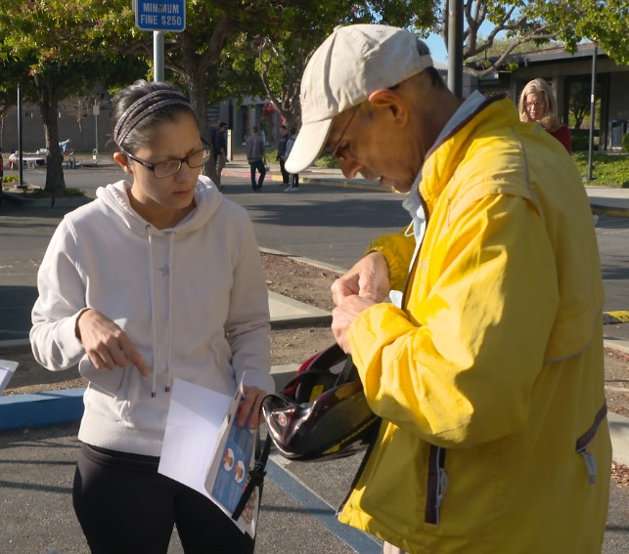
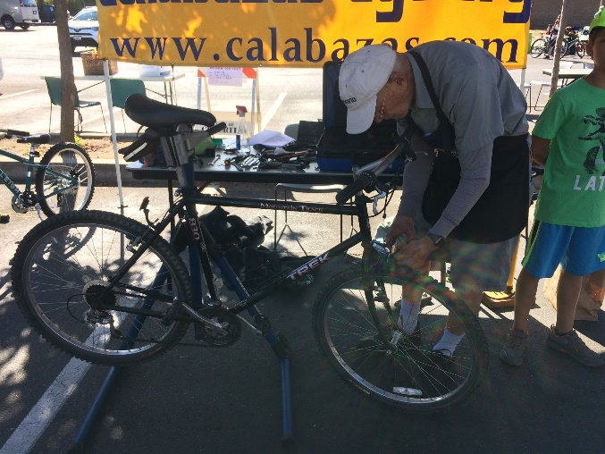
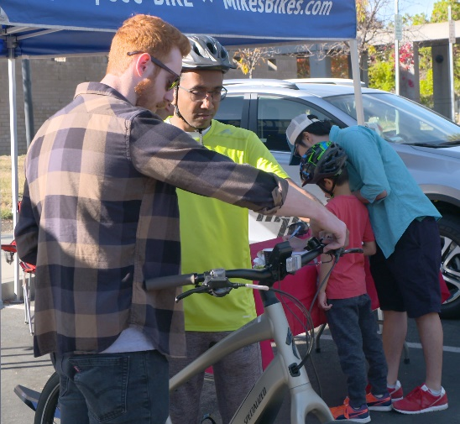
Presentation: October Highlights
Fall Bike Fest
Notes:
The Fall Bike Fest was a great success, thanks to all our partners:
Bicycle Pedestrian Commission: created the flyer, helped publicize, ran the registration booth and blender bike, led the bike rides, and helped clean up
Walk Bike Cupertino: helped advertise the event, and ensured a proper helmet fit for riders
High School Volunteers: helped setup, supervised bike parking, ran the snack table and bike decorating booth
Girl Scout Troop 60657: did face painting
Mike’s Bike’s: eBike demo
Calabazas Cyclery: bike tune-ups
Safe Moves: last but certainly not least - Bike Rodeo
Tacos el Rufles: lunch

Slide 10
Presentation: October Highlights
High School Applicants
Cupertino: 2 students
Homestead: 2 students
Monta Vista: 1 student

Slide 11
Presentation: October Highlights
Fall Travel Tallies
Summary presentation will be uploaded here when finalized:
www.Cupertino.org/SafeRoutes/data

Slide 12
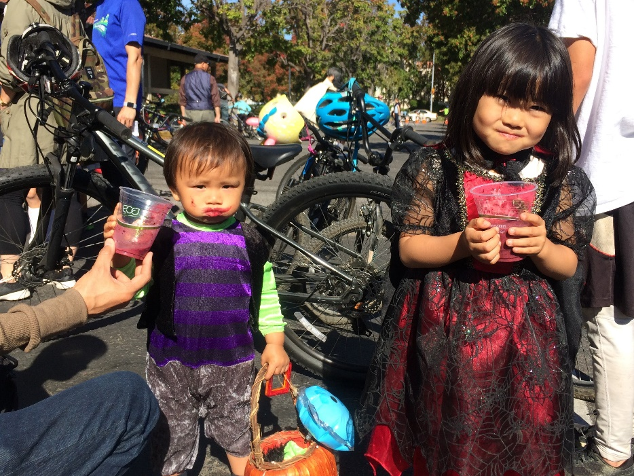
Discussion Item: Next Year’s Dates
Bike Fest 2019 and beyond
Considerations:
4th week in Oct: Halloween
3rd week in Oct: still late in month
International Walk to School Day typically 2nd week in Oct. This year, Oct 2
2nd week in Oct: Diwali
1st week in Oct: Cherie’s birthday
4th week in Sept: no conflicts
Notes:
We need a new date for our Bike Fest. The last week in October conflicts with Halloween activities and is late in the month.
Do we want to tie our Fall Bike Fest to International Walk to School Day?

Slide 13
Discussion Item: Next Year’s Dates
Bike Fest 2019 and beyond
Questions:
Tie to International Walk to School Day?
Or move to September
Notes:
We need a new date for our Bike Fest. The last week in October conflicts with Halloween activities and is late in the month.
Do we want to tie our Fall Bike Fest to International Walk to School Day?

Slide 14
Discussion Item: Next Year’s Dates
Working Group Meetings 2019/20
Considerations:
BPC
City Council
CUSD Board
FUHSD Board

Slide 15
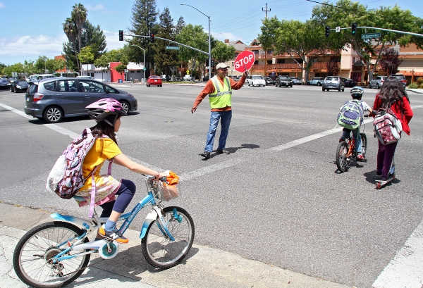
Discussion Item: Summer Bike Skills Workshops
Summer Bike Workshops
Middle School Bike Skills?
Notes:
Over the summer, we piloted two free, 3-hour family bike workshop at the YMCA. The workshop included:
Helmet fit
Bike ABC quick check
In-class presentation (vehicular cyclist movie about rules of the road)
Parking lot skills assessment
In-road Intersection practice
Family bike ride
The workshops were well attended and well received, but it was tricky to have such a wide range of ages all at once, and I would change the in-class portion. I’d like to institutionalize summer cycling workshops, and want to let you know what I’m thinking and get your input.
Wheel Kids is an organization out of Palo Alto that offers Summer Middle School Bike Skills workshops in Palo Alto, Menlo Park, San Mateo, and Los Gatos. The course is aimed at riding 6th and 7tn graders for several reasons:
- Middle school is typically farther away from home than neighborhood elementary schools
In grade school, kids often ride with mom or dad. Middle schoolers are more likely to start biking independently, so more than every, they need to know the rules of the road and how to conduct themselves without adult supervision.
The structure is slightly different than the one we piloted over the summer. It’s 4.5 hours:
45 min in-class presentation (slide show)
45 minute blacktop skills/assessment
2.5 hour street riding to further practice skills (Lunch break included)
My daughter took this course in Palo Alto the summer before 6th grade, and I was very impressed with the program, and would highly recommend it for any middle schooler.
As I work to implement a summer cycling workshop in Cupertino, I want to make sure I am targeting the proper audience.
Qs:
- Middle Schools or other?
- Charge?

Slide 16
Upcoming Events:
November 26th - Wednesday: Homestead Corridor Study – Community Meeting #1, 6-8 PM, Homestead High School Library
January 23rd - Wednesday: Working Group Meeting, 4-5 PM, Conference
Room C

Slide 17
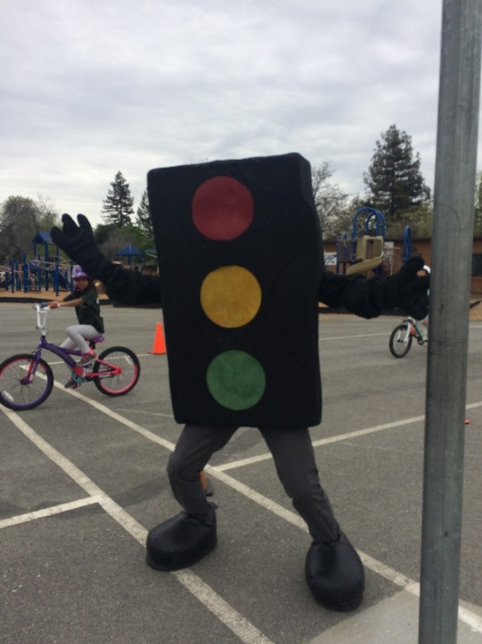
Reminders: Action Items
For schools:
Send rodeo requests to- saferoutes@Cupertino.org
For everyone:
Best contact for program is saferoutes@Cupertino.org

Slide 18
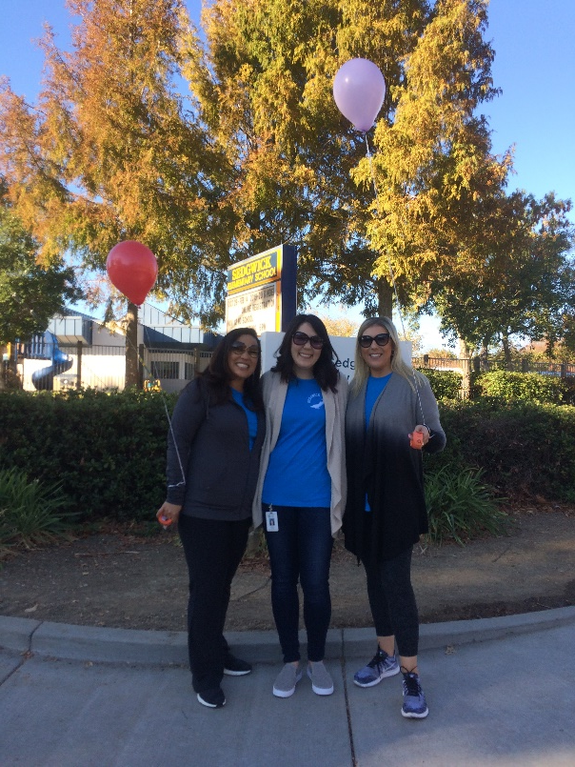
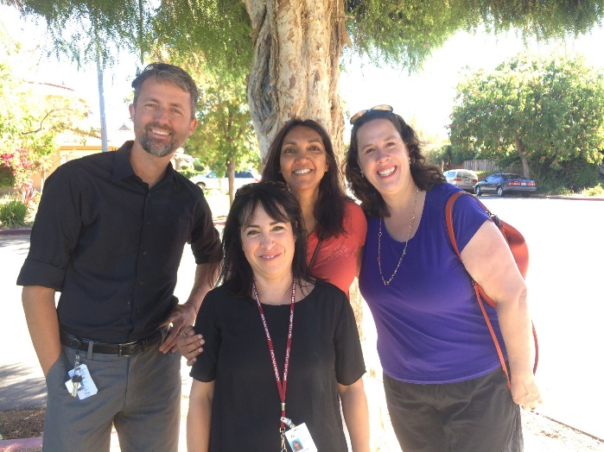
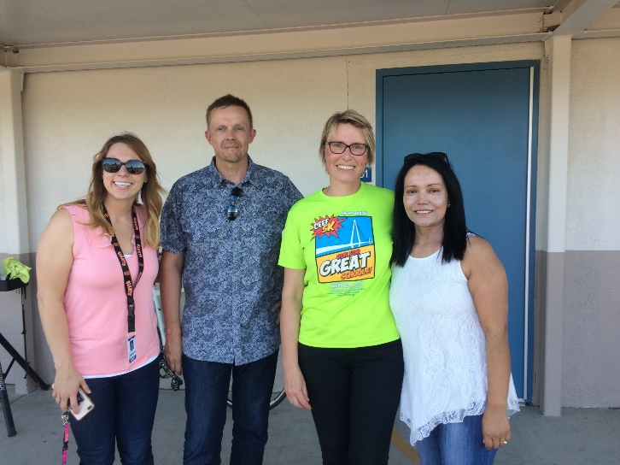
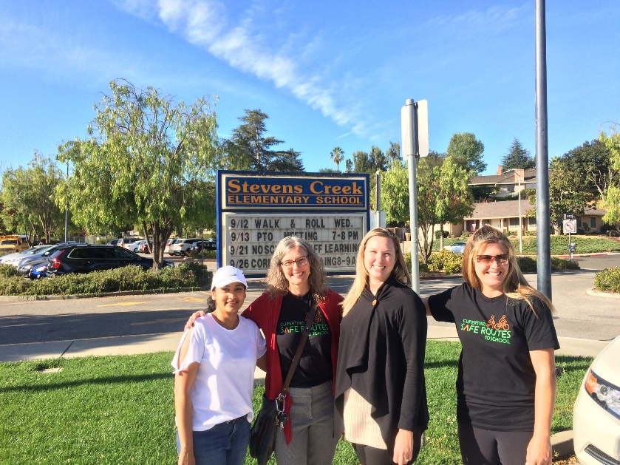
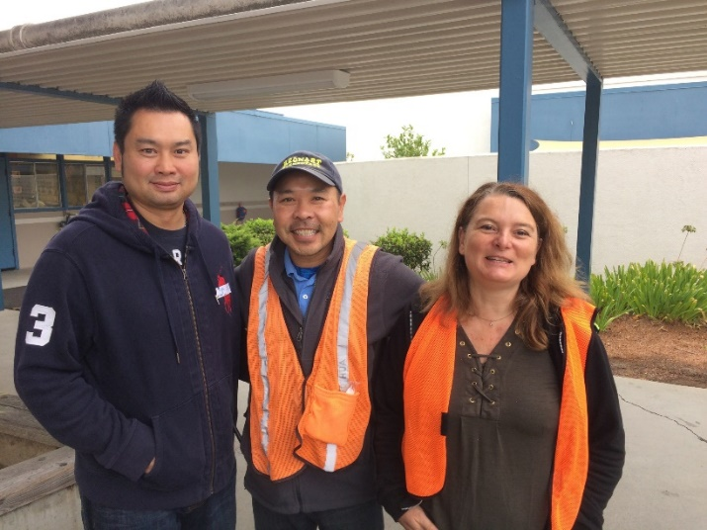
A Big THANK YOU!!
Notes:
Thank you all for coming.

Slide 19
Working Group Meeting Dates:
4-5 PM, Conference Room C
February 12th, 2019 (Tue)
March 13th, 2019 (Wed)
April 10th, 2019 (Wed)
May 21st, 2019 (Wed)
June 12th, 2019 (Wed)
September 25th, 2018 (Tue)
October 24th, 2018 (Wed)
November 14th, 2018 (Wed)
January 23rd, 2019 (Wed)

