Slide 1
Sustainability Commission
FY 2018/19 Accomplishments

Slide 2
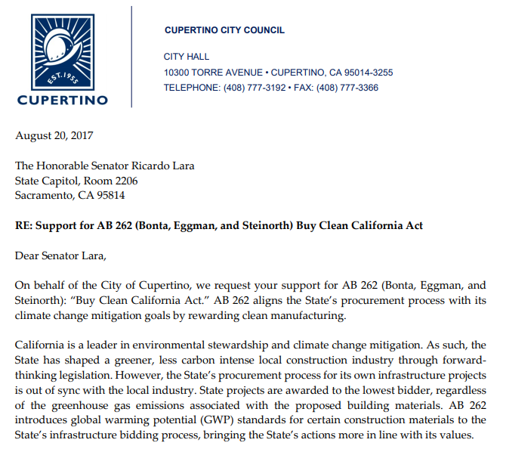
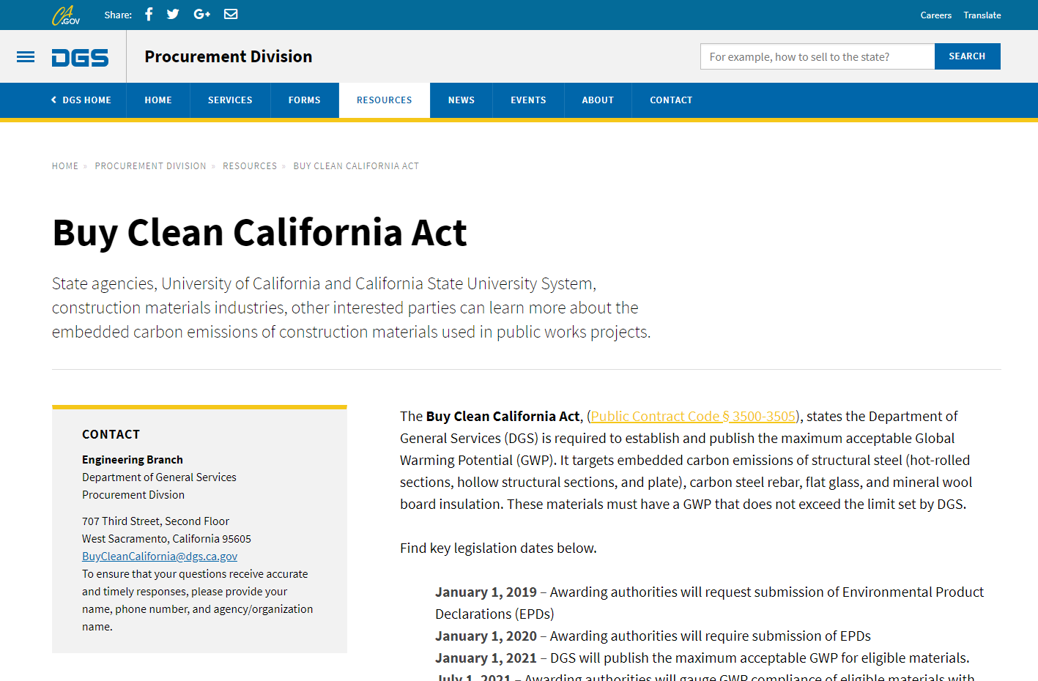
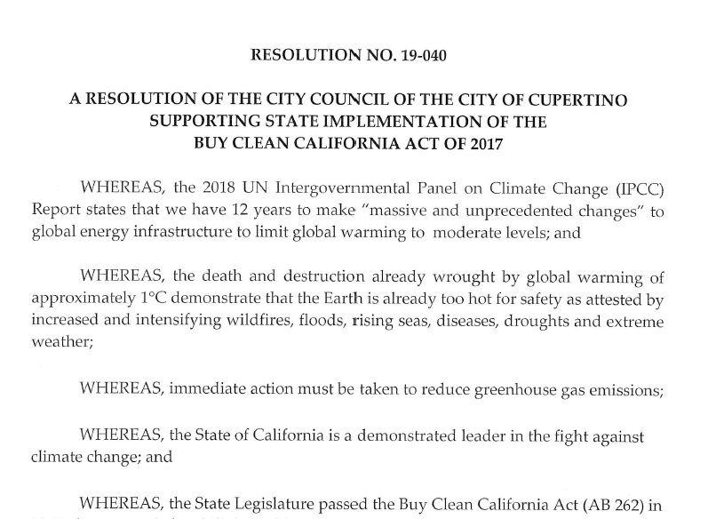
Legislative Action
Buy Clean CA Act
Notes:
FY 19/20 Sustainability Commission Work Program Item

Slide 3
Feedback on Critical Issues
Clean Water & Storm Protection Initiative
Sep, Nov, Jan, Feb, May meetings
Council Work Program item
CalGreen Code Update
Jan, Feb meetings
Council Work Program item

Slide 4
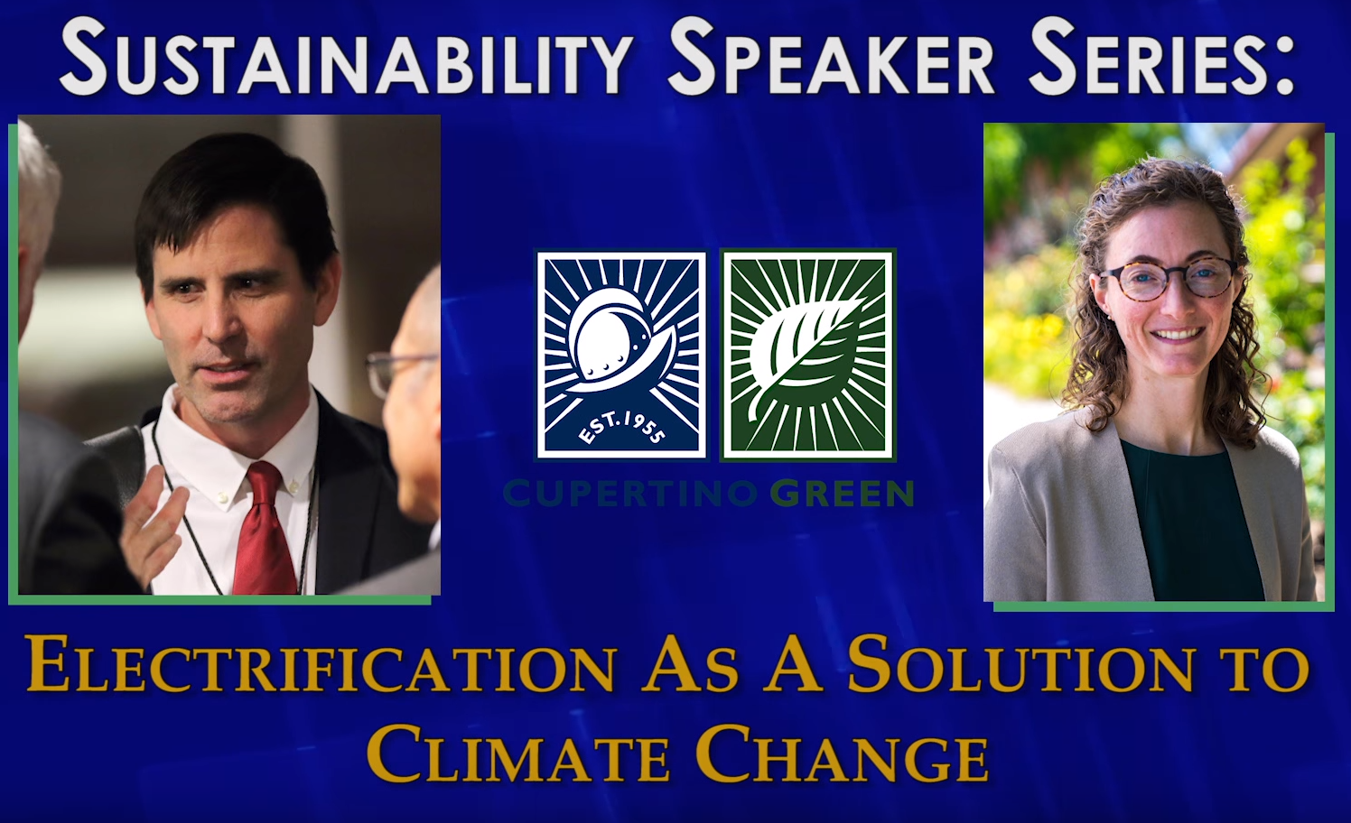

Notes:
50 people in attendance
October 18, 2018
Professor Mark Jacobson discussed the development of technical and economic roadmaps to convert energy infrastructures of buildings, towns, cities, states, and countries to those powered with 100% wind, water, and sunlight (WWS) combined with electricity, heat, cold, and hydrogen storage and energy efficiency.
Dr. Aimee Gotway Bailey shared Silicon Valley Clean Energy's efforts to procure carbon free electricity and the vision to decarbonize.

Slide 5
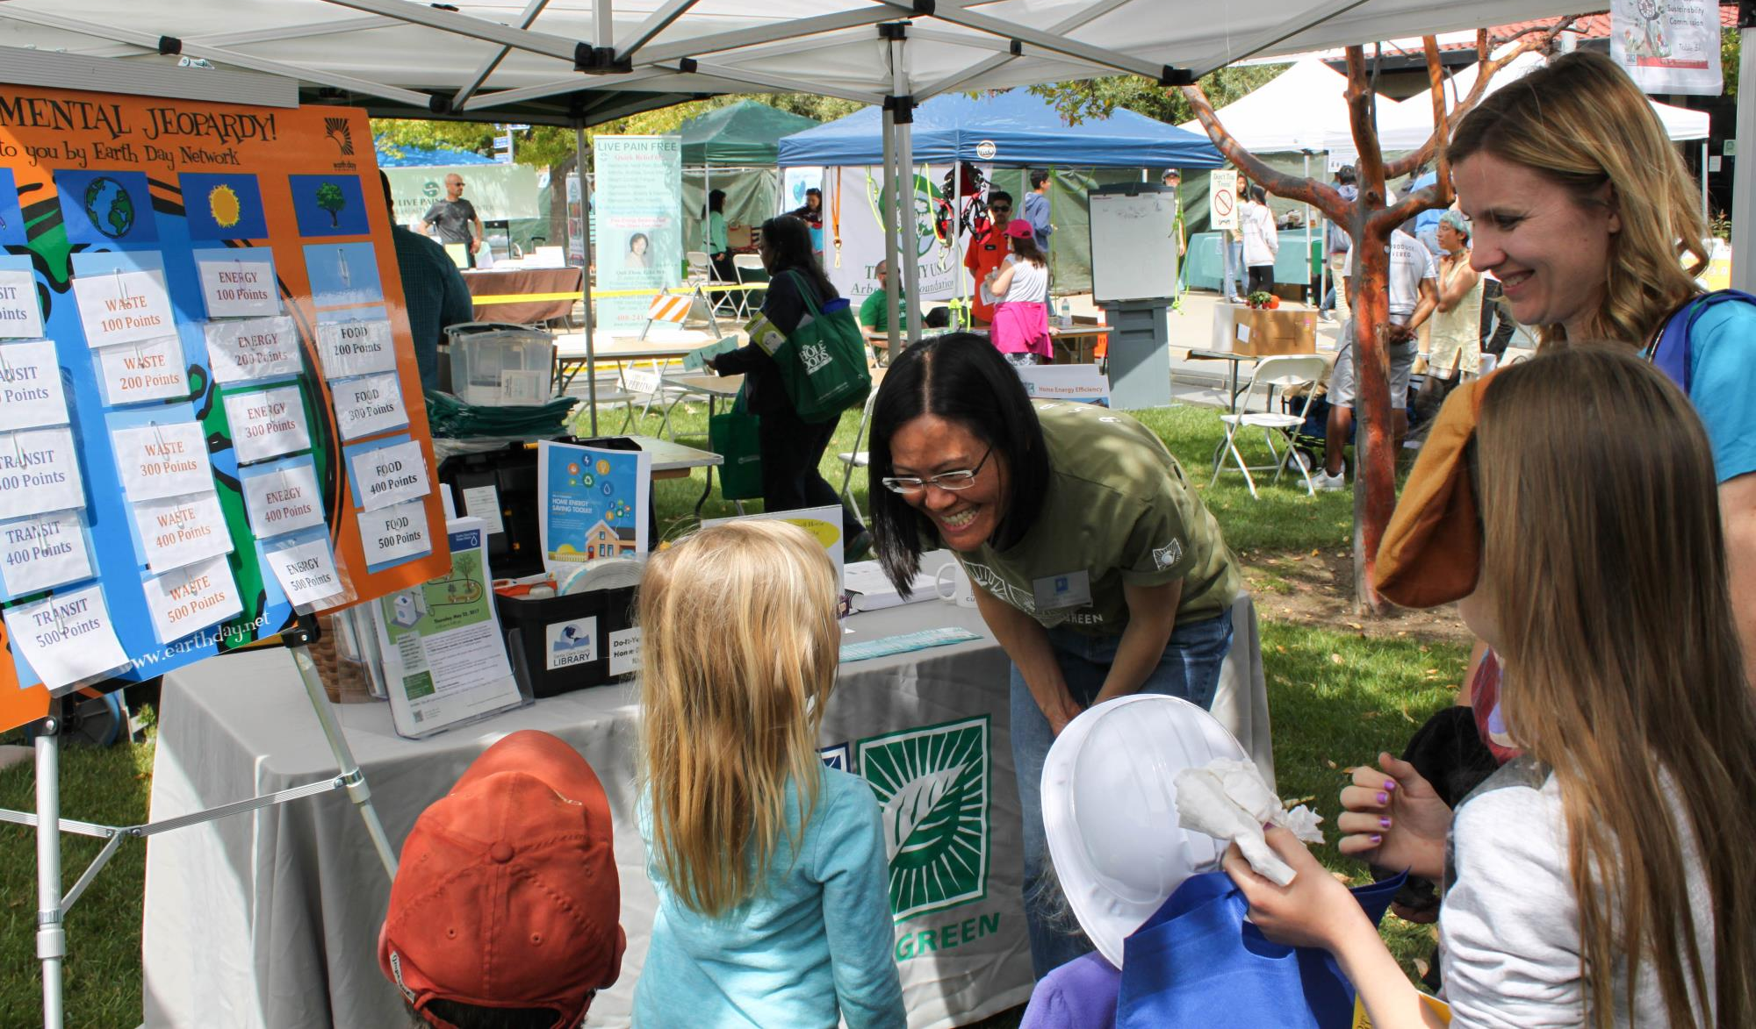
Community Outreach
Notes:
Earth Day tabling
Fall Festival tabling
Green New Deal presentation to Cupertino High Environmental Club

Slide 6
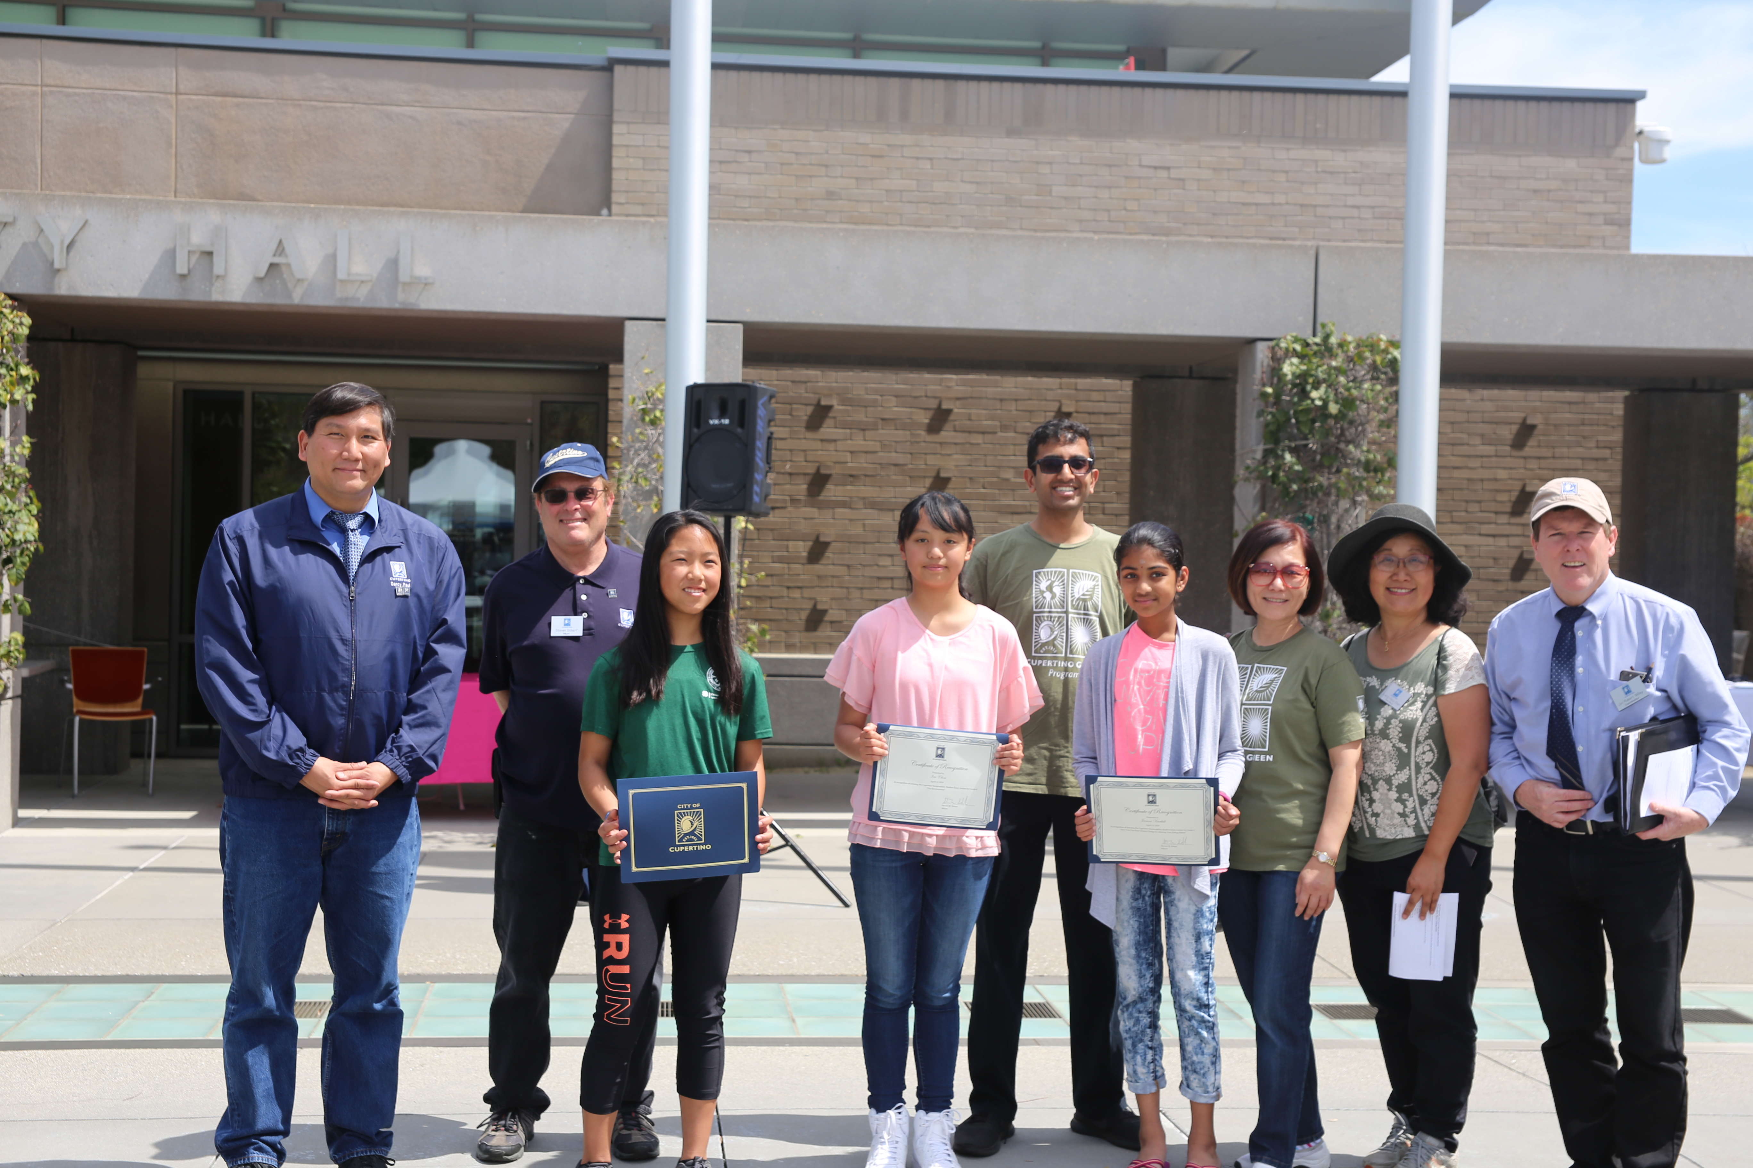
Student Essay Contest
Notes:
Over 40 entrants
CUSD students; Grades 6, 7, and 8
$100 prize per grade
Winners honored @ Earth Day & Arbor Day Festival:
Janani Karthik - Grade 6, Essay titled: “How You Can Stop Climate Change By Altering Your Eating Habits”
Mela Lin – Grade 7, Essay Titled: “How Can We Change Our Habits to Lead to a More Sustainable Environment?”
Iris Chou – Grade 8, Essay Titled: “Our Environment”

