Slide 1
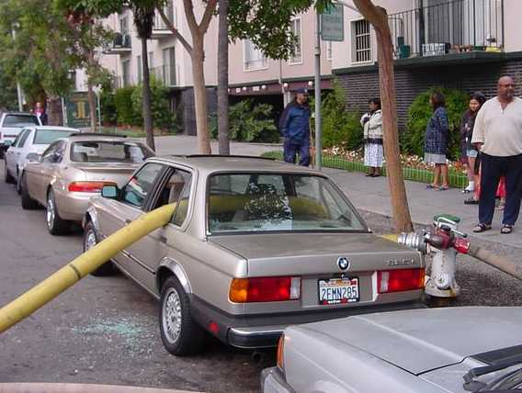
Possible Hazards for this Area?
Earthquakes
Fires
Floods
Hazardous Materials
Landslides
Pandemic
Terrorism
Transportation Accidents

Slide 2
Are you prepared?
Learn simple, basic safety skills to keep your home and family safe!
• When and how to turn off the gas
• How to use a fire extinguisher
• What to do when phones don’t work
• Earthquake emergency supplies
• Medical aid for the first five minutes after event
• Community Emergency Response information
• What’s the City’s plan and what is your role
Be ready, free emergency prep workshops
RSVP to Ken at KennethE@cupertino.org or 408-777-3176

Slide 3
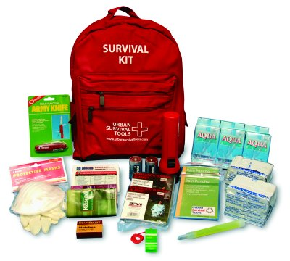
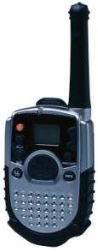
Emergency Supplies
The Top Supplies
Flashlight
Water
Radio
FRS/GMRS
Food
PPE
First Aid Kit

Slide 4
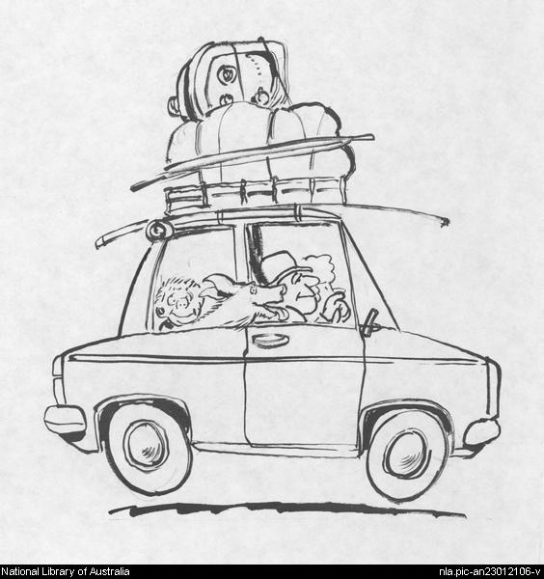
Optional Supplies
Basic Tools
Maps
Toys/Games
For Kids
Spare Tire
Jumper Cables
Blanket
Fire Extinguisher
Clothes
Animal Food
Toiletries
Prescription
Medications
Extra Eyeglasses

Slide 5
Response
Day to day emergencies 911 few minutes
  Sheriff, Fire, Public Works, etc
Regional event and all emergency resources are busy
  we take care of ourselves, family and neighbors using our PEP, CERT, First Aid, CPR, training

Slide 6
Eyes and Ears
Where does the City get it’s situation status
  Employees
  Residents
    Block Leaders
    Neighborhood Watch
    Citizen Corps

Slide 7
Cupertino’s Reporting Zones

Slide 8
What does the City Manager need to know?
Injuries, Structural Damage, Hazards and Access issues
Reporting
  Now we can report without leaving your neighborhood

Slide 9
How can you report your status
Your Neighborhood Name
Preliminary Status Report
Zone: MV, Reg, GG, DA, Law, Crk
Page of
Date /Time _______________
Addresses |  | Injuries | Structure |  |  | Fire |  | Hazards |  |  |  |  | Access (describe)
 |  | Number of Injuries & Description | Light | Moderate | Heavy Describe | On | Out | Gas | Sewer | Water Main | Electric Power |  | Road Block | Other
# | ST | Red-Immediate Life Threatening Yellow-Delayed treatment Green-Minor injury | Broken Windows Cracked/Fallen Chimney or Fence | Large Amount Cracking on Exterior Possible Interior Damage | Partial / Full Collapse Off Foundation Structural Damage |  |  | Leak | Leak | Break | Lines Down | Power On
14451 | Main St | 2 Red, 4 Yellow |  | X |  |  |  | Y | N | N | N | N | N

Slide 10
How do we do that ?
Your safety #1
  Take care of yourself, family, home
  Survey your neighbors
  Take care of any immediate neighborhood issues
  Report your status
    Use the form to collect your status
    Turn on your FRS radio and deliver your report to your ARK

Slide 11
Block Leader to ARK Communications
Radio Plan
  Each ARK has FRS/GMRS
  Tested 4 Zones
  Trained staff to receive and transmit messages

Slide 12
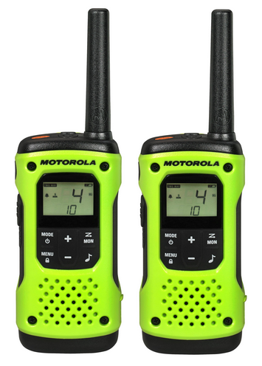
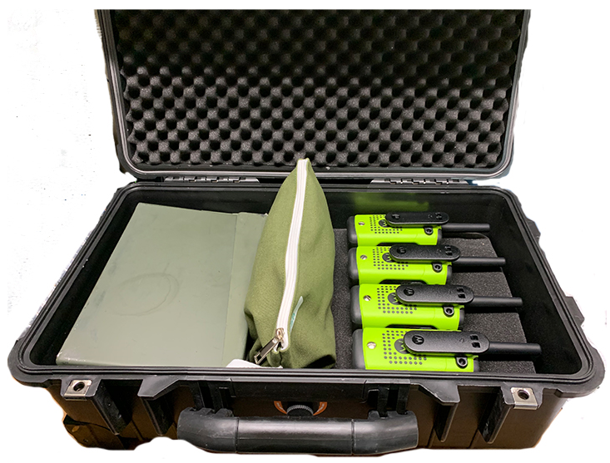
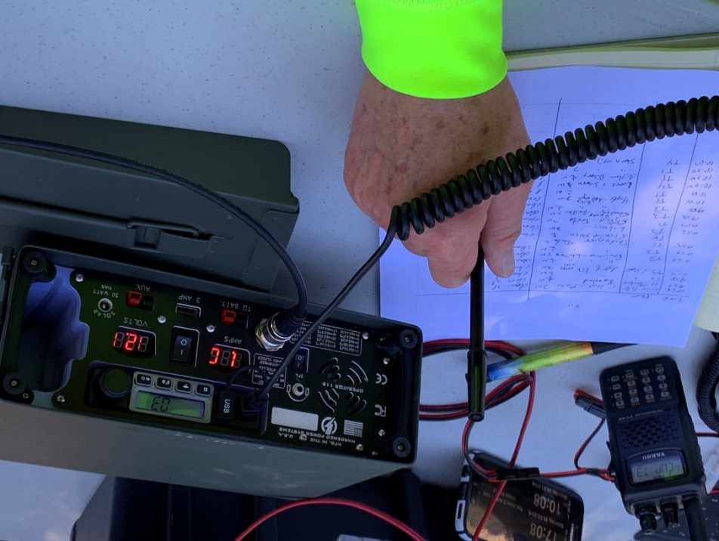
Equipment
FRS/GMRS
Kit at each ARK
Base Station

Slide 13
Block Leaders radio familiarization plan
Let’s Practice
    Zone by Zone
    Meet at ARK or Zoom to be safe
    Set up radios
    Go home and radio back to ARK
    Schedule to be announced

Slide 14
Questions?

