Slide 1

Your VSP
Vision Benefits
Members First,
Members for Life
City of Cupertino
Notes:
Thank you for taking the time to learn more about the vision benefits City of Cupertino is offering you in partnership with VSP Vision Care.

Slide 2
City of cupertino
City of Cupertino is offering two VSP vision plans for you to choose from.
Signature Plan
Signature Plan with ProTec Safety
Notes:
CITY OF CUPERTINO is offering two vision plans for you to choose from – The VSP Signature Plan
and the VSP Signature Plan with ProTec Safety. The Protec Safety benefit is available to employees only.
Now let’s take a look at both plans so you can select the right one for you.

Slide 3
VSP Plans at a glance
 | Signature Plan | Signature Plan with ProTec Safety
Exams | WellVision Exam® covered every 12 months $20 Copay. | WellVision Exam® covered every 12 months $20 Copay.
Frame Allowance | $130 Frame allowance every 24 months. | $130 Frame allowance every 24 months.
Lenses | Single vision, lined bifocal or lined trifocal lenses $20 Copay included in glasses every 12 months. Impact-resistant lenses covered in full for children, after copay. | Single vision, lined bifocal or lined trifocal lenses $20 Copay included in glasses every 12 months. Impact-resistant lenses covered in full for children, after copay.
Lens Enhancements | Standard Progressive lenses covered in full 35-40% savings on lens enhancements– Scratch-resistant, UV, Anti-glare coating | Standard Progressive lenses covered in full 35-40% savings on lens enhancements– Scratch-resistant, UV, Anti-glare coating
Contact Lens Allowance (in lieu of glasses) | $130 allowance for contacts lenses and copay up to $60 for contacts lens exam (fitting and evaluation) | $130 allowance for contacts lenses and copay up to $60 for contacts lens exam (fitting and evaluation)
ProTec Safety (Employee Only Coverage) | N/A | Frame fully covered when you choose a safety frame from your VSP doctor's ProTec Safety Eyewear® collection every 24 months with a $10 Copay for frame and lenses. Prescription single vision, lined bifocal, and lined trifocal, every 12 months Certified according to the American National Standards Institute (ANSI) guidelines for impact protection
VSP Primary EyeCare PlanSM (PEC) | Provides supplemental coverage for non-surgical medical eye conditions. $20 Copay
Retinal Screening | No more than a $39 copay on routine retinal screening as an enhancement to a WellVision Exam®
Notes:
Whether you choose the VSP Signature Plan or VSP Signature Plan with ProTec Safety, you will receive great savings when you visit a VSP network doctor.
Signature Plan:
A WellVision Exam is covered in full every 12 months with $20 copay.
Includes a frame allowance of $130 every 24 months.
Prescription lenses are covered every 12 months with a copay of $20.
Or, you can choose contacts instead of glasses every 12 months with a $130 contact lens allowance and a copay up to $60 for the contact lens exam.
Fully covered prescription single vision, lined bifocal or lined trifocal lenses, as well as impact-resistant lenses for children after copay.
Your plan will also offer savings of 35-40% on lens enhancements such as Scratch-resistant, UV or Anti-glare coatings.
VSP Primary EyeCare Plan, which provides supplemental coverage for non-surgical medical conditions. $20 Copay
Signature Plan with Protec Safety – Same Signature Plan benefits with the Protect Safety included:
Protec Safety is for Employee only.
Frame fully covered when you choose a safety frame from your VSP doctor's ProTec Safety Eyewear® collection. Every 24 months with a $10 Copay (combined with lenses).
Prescription single vision, lined bifocal, and lined trifocal . Every 12 months
Certified according to the American National Standards Institute (ANSI) guidelines for impact protection

Slide 4

WHY CHOOSE VSP?
The only national
not-for-profit vision
insurance company¹
Quality care.
64 years of helping people
see well and stay healthy
More choices.
Nationwide network of
more than 38,000 providers
88 million
members nationwide
Providing no-cost eye care through Eyes of Hope®
Great value!
VSP® is consumers’ #1
choice In vision care²
1. VSP insurance plans have exclusions and limitations. For costs and complete details of the coverage, contact VSP at 800.877.7195.
2. National Vision Plan Member Study, 2017.
Notes:
As the only national not-for-profit vision insurance company, VSP is committed to our members wellness over profit. We have 64 years of helping people see well and stay healthy. Our Eyes of Hope® charitable program provides no-cost eye care and eyewear for more than 2 million adults and children in need. With 88 million members worldwide, it’s easy to see why VSP is consumers’ #1 choice in vision care.

Slide 5

VSP protec safety® plan
Receive an annual eye exam from a VSP doctor who specializes in safety eyewear services
Prescription safety lenses and frame are
fully covered when you choose a pair from
a VSP ProTec Eyewear® collection*
More than 2,000 workplace eye injuries happen each year.
90%
Can be prevented with protective eyewear**
*Less any applicable copays
**EyeSmart.org, Eye Health Information from the American Academy of Ophthalmology.
Notes:
With the ProTec Safety Plan, you get an affordable benefit that includes a fully covered safety frame from the ProTec Eyewear collection, along with prescription lenses that meet current impact protection standards for maximum safety
STATS
2,000 job related eye injuries require medical treatment
90% of job-related injuries are preventable
5% of employees lose one day of work due to injuries
33% of employees injuries require treatment in the ER

Slide 6

Premier Program Savings
Save even more and get more through extra offers, like additional savings on frames, lenses, and contacts that are exclusive to Premier Program locations.
Access to exclusive Bonus Offers
A wide selection of featured frame brands¹
Eyewear protection warranty
The latest in performance lenses
An advanced eye exam
Participation in the VSP preventive
eye health and wellness program
Notes:
Members have access to additional savings when you visit a Premier Program location, including;
Exclusive bonus offers available only at Premier Program locations
A wide selection of featured frame brands, backed by a one year worry-free warranty if your glasses are broken or damaged
Access to the latest in high-definition technology with UNITY® digital lenses available
Advanced eye exam technology, like retinal imaging
Participation in the VSP preventive eye health and wellness program, for early detection of eye and other health conditions
1. Brands subject to change.

Slide 7

RETINAL SCREENING
The digital imaging system takes a picture of the inside of your eye and helps your VSP network doctor detect and manage eye and health conditions like–glaucoma, diabetes, and macular degeneration.
Finding retinal disorders early is critical to potentially preventing serious disease progression and even vision loss.
$39 copay for Retinal screening
Notes:
Retinal Imaging
The digital imaging system takes a picture of the inside of your eye and helps your VSP network doctor detect and manage eye and health conditions like–glaucoma, diabetes, and macular degeneration. Finding retinal disorders early is critical to potentially preventing serious disease progression and even vision loss.
Offered for a low copay of $39

Slide 8
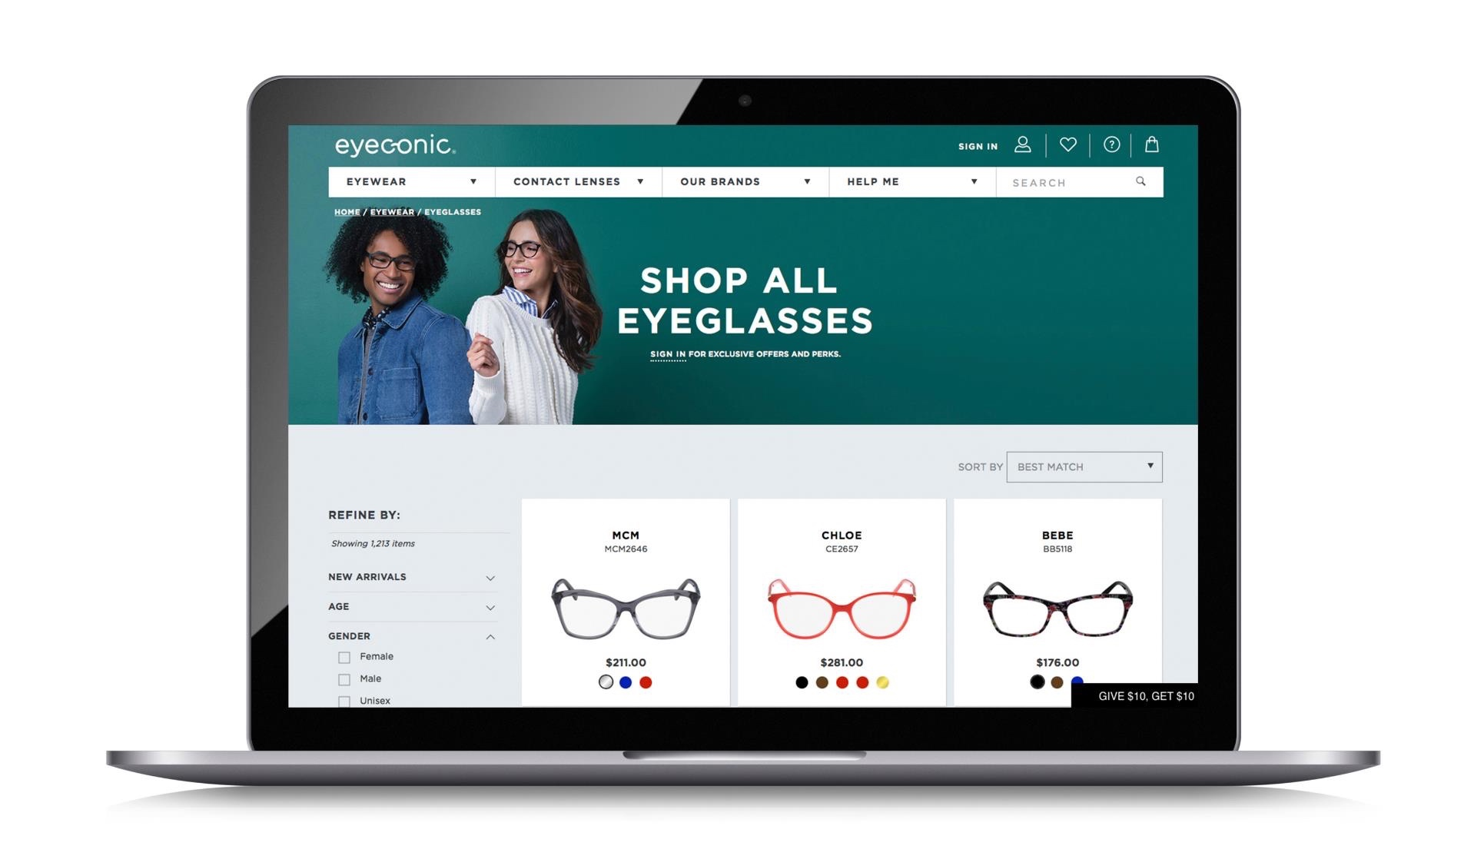

Eyeconic.com
Eyeconic is the only place where
VSP members can shop online for contacts and eyewear with their
VSP insurance in-network.
Personalized: As a VSP-owned company, Eyeconic seamlessly connects VSP vision benefits to your account.
Simple: Save time and money on quality eyewear with a few easy clicks.
Connect your vision insurance.
Select your product.
Upload your prescription or provide your doctors contact information and we’ll take care of the rest.
Choice: Eyeconic offers a variety of well-known brands and contact lenses. Choose from over 35 eyewear brands and over 1600 styles.
Notes:
Eyeconic is the only place where VSP members can shop online for contacts and eyewear with their VSP insurance in-network.
As a VSP-owned company, Eyeconic seamlessly connects VSP vision benefits to a members’ account. By applying vision benefits, they see savings in real time.
Save time and money on quality eyewear with a few easy clicks.
1. Connect your vision insurance
2. Select your product
3. Upload your prescription or provide your doctors contact information and we’ll take care of the rest.
Eyeconic offers a variety of well-known name brands and contact lenses. Choose from over 35 eyewear brands and over 1600 styles.

Slide 9





Exclusive Member Extras
Big Value. More Saving with VSP Vision Care.
With Exclusive Member Extras, savings never looked so good. VSP puts members first by providing you with exclusive special offers from leading industry brands, totaling more than $3,000 in savings. Discover great deals on glasses, sunglasses, contact lenses, and more.
Special Deal on Glasses—
Extra $20 on Featured Frame Brands
Save 25-40% on popular lens enhancements
Save Up to $50 on Non-prescription Sunglasses
*Offers vary based on benefit plan.
Notes:
As a VSP member, you get access to Exclusive Member Extras. We put our members first by providing exclusive special offers from leading industry brands, totaling more than $3,000 in savings. Discover great deals on glasses, sunglasses, contact lenses and more.
Special deal on glasses – extra $20 on featured frame brands
Up to 40% off lens enhancements. (Depending on the client’s MBS, the lens enhancement savings are either 25-25% or 35-40%.)
Save up to $50 on non-prescription sunglasses
Visit vsp.com to see additional savings on contacts, LASIK, diabetes care, hearing aids, and financing
Offers vary based on your benefit plan

Slide 10

UsING Your benefit is easy
Once you’re enrolled…
Create an account at vsp.com and review your benefit information
Find a VSP in-network doctor by visiting vsp.com or calling 800.877.7195
No ID card needed, at your appointment, simply tell them you have VSP
Notes:
And using your VSP benefit is easy. Once your plan is effective, you can create an account on vsp.com to review benefit information and view the doctor network so you can find an eye care provider who’s right for you. And don’t forget you can maximize your savings when you visit a Premier Program location. Then, at your appointment, simply tell the doctor’s office you have VSP. There’s no ID card necessary.

Slide 11


ENROLL
TODAY!
Enjoy the complete coverage
and quality care you deserve.
To learn more contact us
at 800.877.7195 or vsp.com.
©2019 Vision Service Plan. All rights reserved.
VSP, Eyeconic, eyeconic.com, Eyes of Hope, and WellVision Exam are registered trademarks of Vision Service Plan. All other brands are the property of their respective owners. 40152 VCCL
Notes:
Choose VSP to get the complete coverage and quality you deserve, at a price you want. To learn more contact us at 800.877.7195 or visit vsp.com

