Slide 1



Crime in 2020; Did COVID-19 Increase or Decrease it?

Slide 2
Crime in 2020; Did COVID-19 Increase or Decrease it?
COVID-19 Impact on Operations
Crime Statistics
Identity Theft/Scams/Fraud
New programs and initiatives

Slide 3
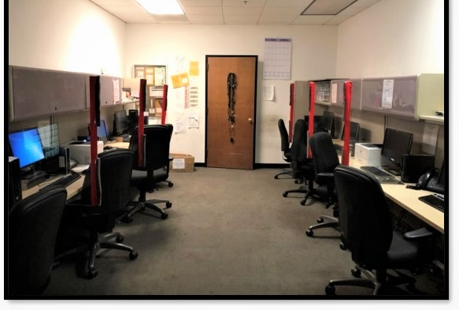
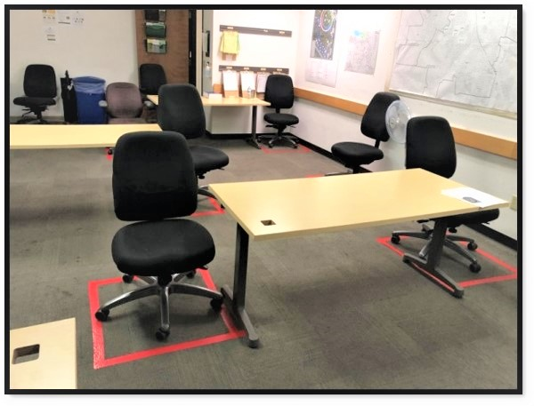
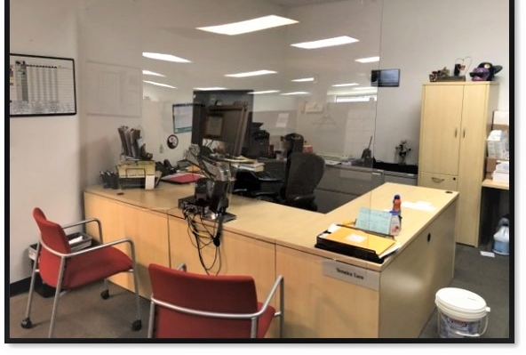

Slide 4
Priority 2: Urgent but not life threatening
Priority 1: Life Threatening
Priority 3: Cold incidents; as other priority calls allow

Slide 7
Residential Burglaries

Slide 8
Residential Burglaries
In 41 of the reported cases, time of burglary occurred over course of multiple days, exact day of week unknown

Slide 9
Commercial Burglaries

Slide 10
Vehicle Burglaries
Of note, vehicle burglaries increased by 67% in residential areas and decreased by 72% in commercial areas as compared to 2019.

Slide 11
Identity Theft/Forgery/Fraud

Slide 12

Most Common Fraud in 2020
  Top fraud of 2020 was scams!
  1.2 billion loss; median loss of $850
  Second was online shopping and negative reviews due to Covid.
  Telephone calls/text most common way to scam us!
Source: https://www.consumer.ftc.gov/blog/2021/02/top-frauds-2020

Slide 13



Victim trying to buy a new phone. The thief gave instructions to the victim to allow access to her phone remotely using an application. Victim allowed access.
Thief instructed victim open her bank mobile application and use the “Zelle” application within the bank application to send him $900 for a new phone.

Slide 14
Thief claimed to be victim’s grandson. Second victim claimed to be attorney for grandson and asked to send $20,000 to bail grandson (thief) out of jail. Victim deposited the money into an unknown bank account through her bank.

Slide 15
Victim logged into XXXX.com and received a pop-up-ad claiming to be XXXXX security and requesting that victim call them due to recent security problems. A phone number was provided, and the victim spoke with “several people.”
Victim noticed deposits in his account and began to work with his “bank” to send the money to the correct owner in a different country. After about a month, victim realized he was scammed and lost over $500,000.

Slide 16
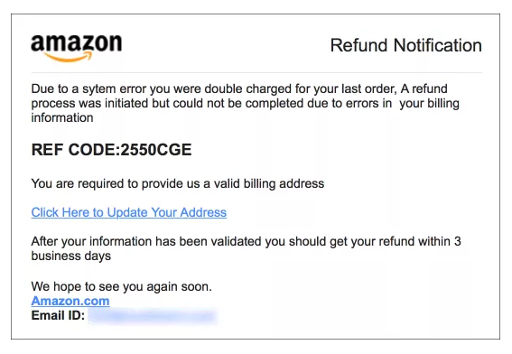
Real or Scam?

Slide 17
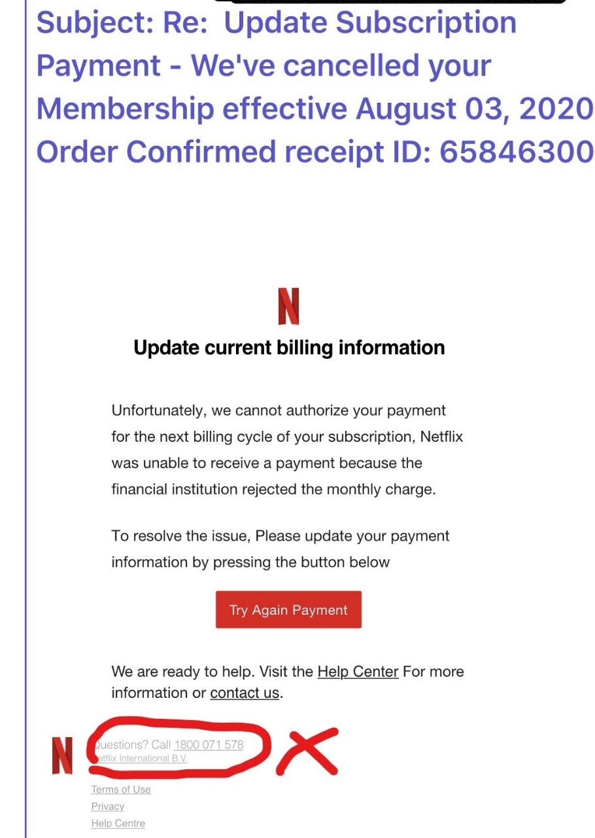
Real or Scam?

Slide 18
How do I mitigate fishing scams?
Protective computer by using security software.
Protect your mobile phone by updating software automatically.
Protect accounts by using multi-factor authentication.
Protect information by backing-up data.

Slide 19
Telephone Scams
Ignore random calls.
1
Do not share any personal information.
2
Call the organization/person back after research.
3
Take your time, don’t feel rushed.
4

Slide 20
Have I been a Victim of Identity Theft?
www.Equifax.com or 1.800.525.6285
www.Experian.com or 1.888.397.3742
www.TransUnion.com or 1.800.680.7289
“Fraud Alert” or “Security Freeze”

Slide 21

Upcoming Initiatives and Programs
Teen Driving Diversion Program
Online Incident Reporting
Customer Satisfaction Survey Cards
Deputy Training
Psychiatric Emergency Response Team (PERT)

Slide 22
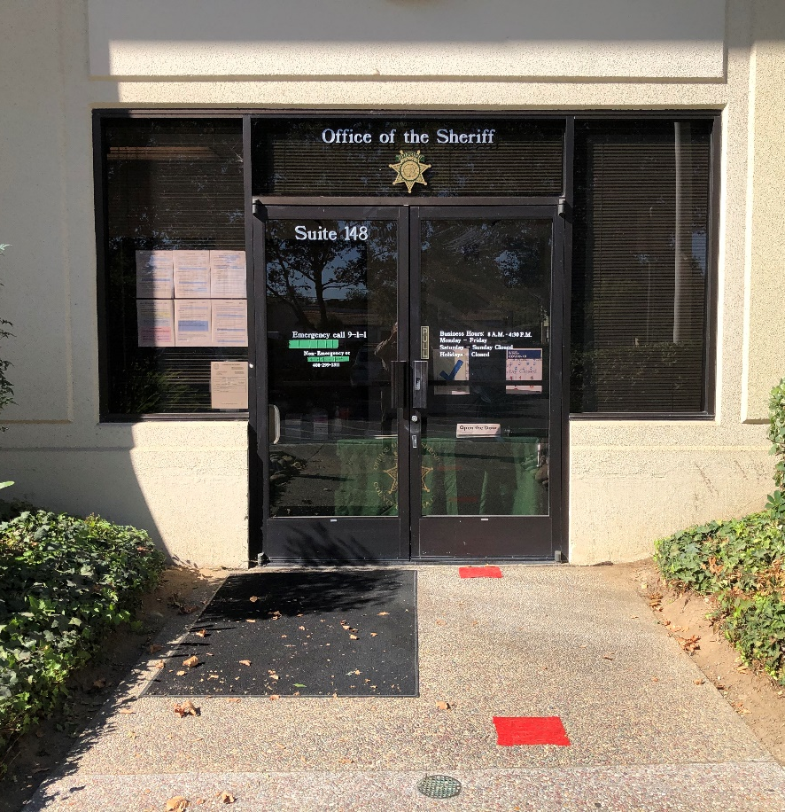
Sheriff’s Office West Valley Substation
408.299.2311
Non-Emergency
Emergency 9-1-1 or Text 9-1-1
408.868.6600
Administrative Offices
1601 S. De Anza Boulevard Suite 148 Cupertino, CA 95014

Slide 23
THANK YOU!

