Slide 1
De Anza Blvd Buffered Bike Lanes
Community Meeting
September 12, 2024
David Stillman, Transportation Manager

Slide 2
Topics
Project Genesis
Project Purpose
Project Description
Project Details
Traffic Effects
Next Steps

Slide 3
Project Genesis
Council Approved 2016 Cupertino Bicycle Transportation Plan
  List of prioritized projects
  Highest ranking Tier 2 project
Council approved CIP FY 2022-23
Bicycle Pedestrian Commission
  December 2022, April 2023, July 2023
City Council
  April 2024 contract approved
  $530k, $166k grant funded

Slide 4

Project Purpose
Enhance bicyclist safety
  Bikes account for 25% of all crashes
  Bicyclists account for 31% of all serious injuries and fatalities
Bicyclists are vulnerable, responsibility to provide infrastructure that enhances protection
Vision Zero Guiding Principal – human life is more important than speed, convenience or property

Slide 5
Project Description
Limits - Homestead Rd to Bollinger Road
Provides buffer zone between bike lane and vehicle lane
  Two-foot minimum painted buffer
No physical barriers
Vehicle lanes reduced from 4 to 3 in some segments

Slide 6
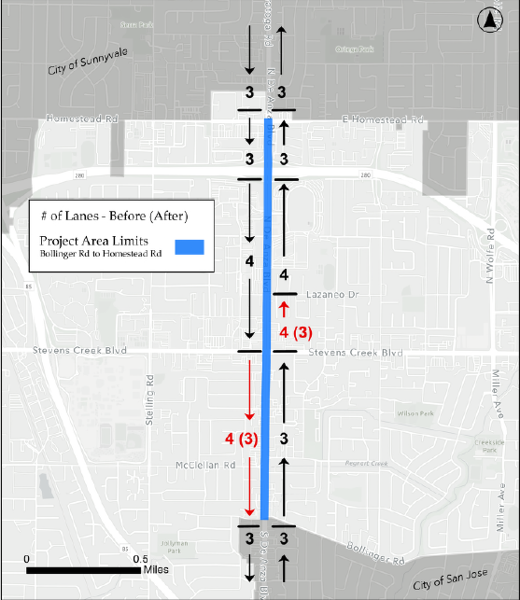
Project Description

Slide 7
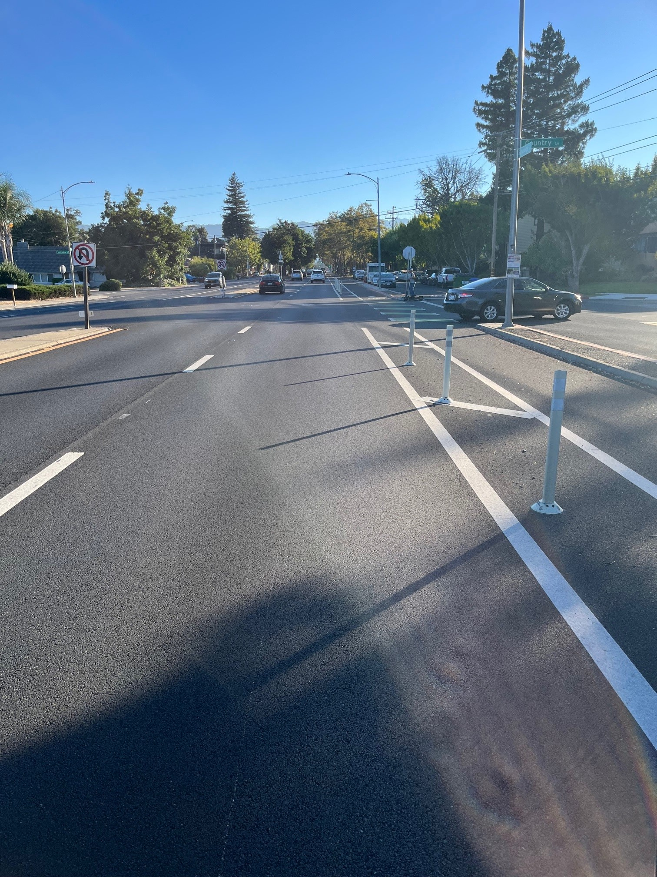
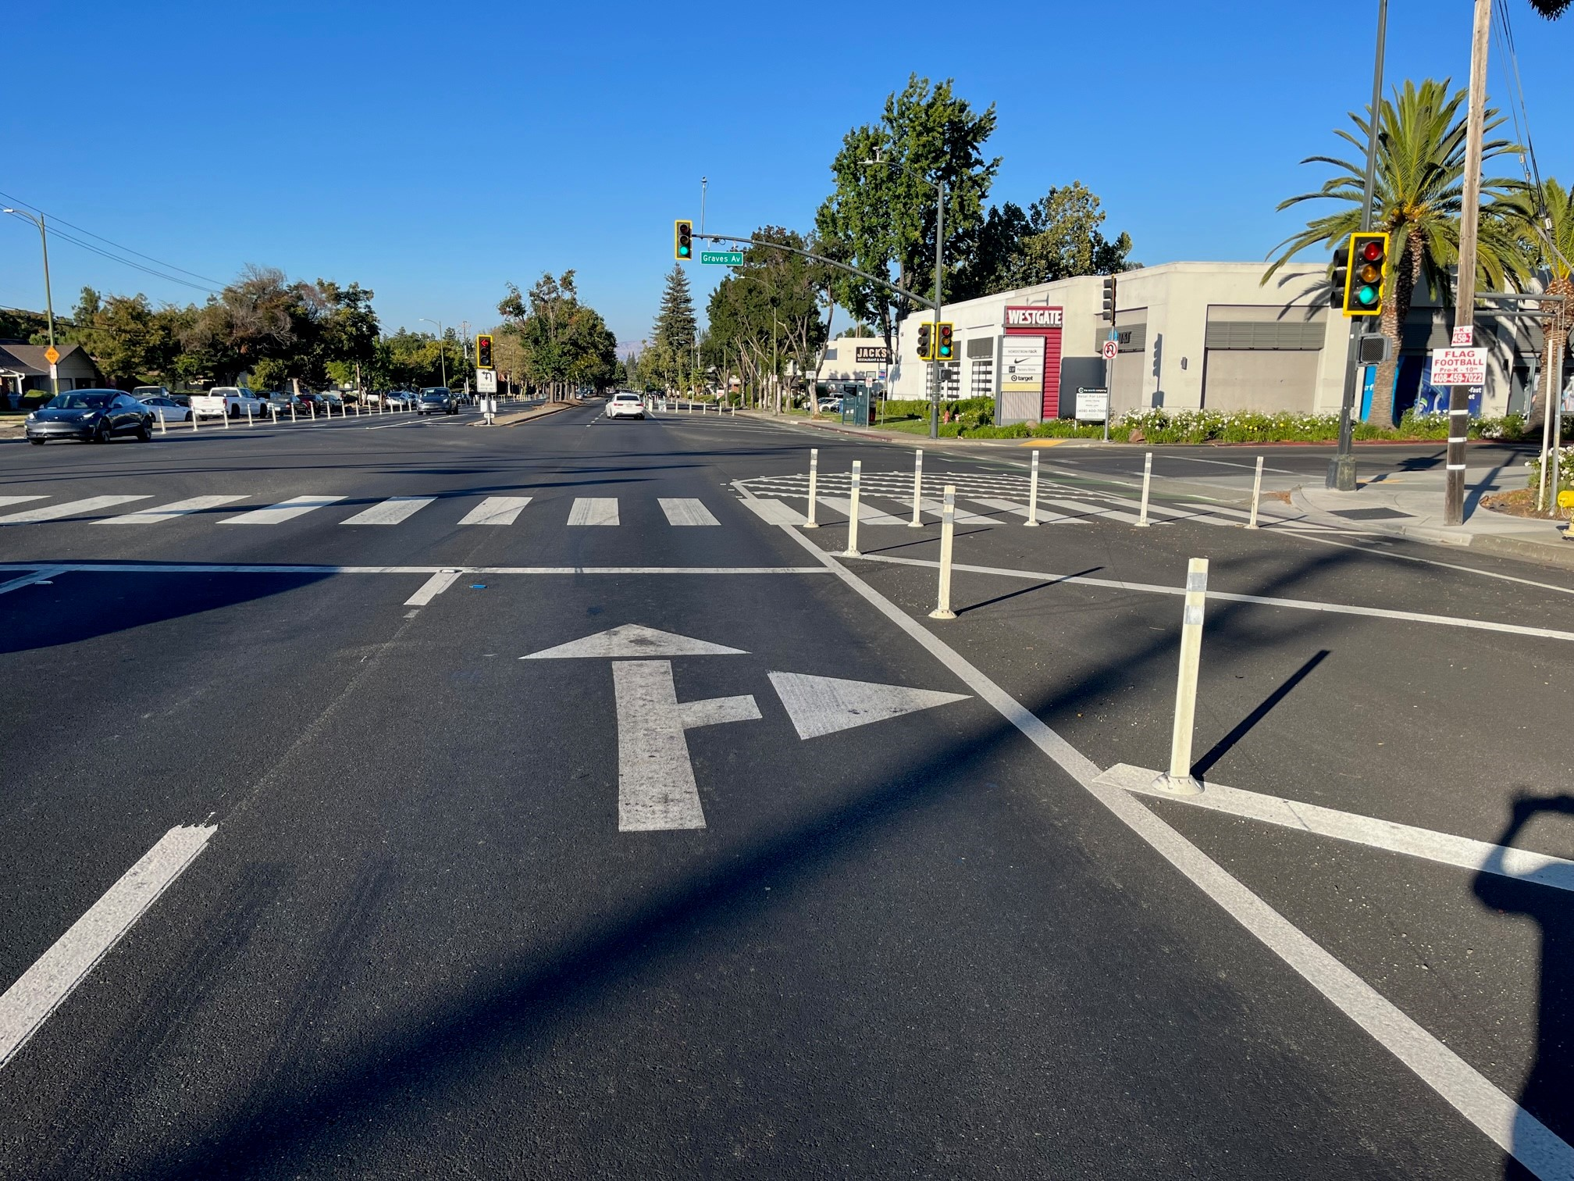


Project Description – What It Isn’t

Slide 8
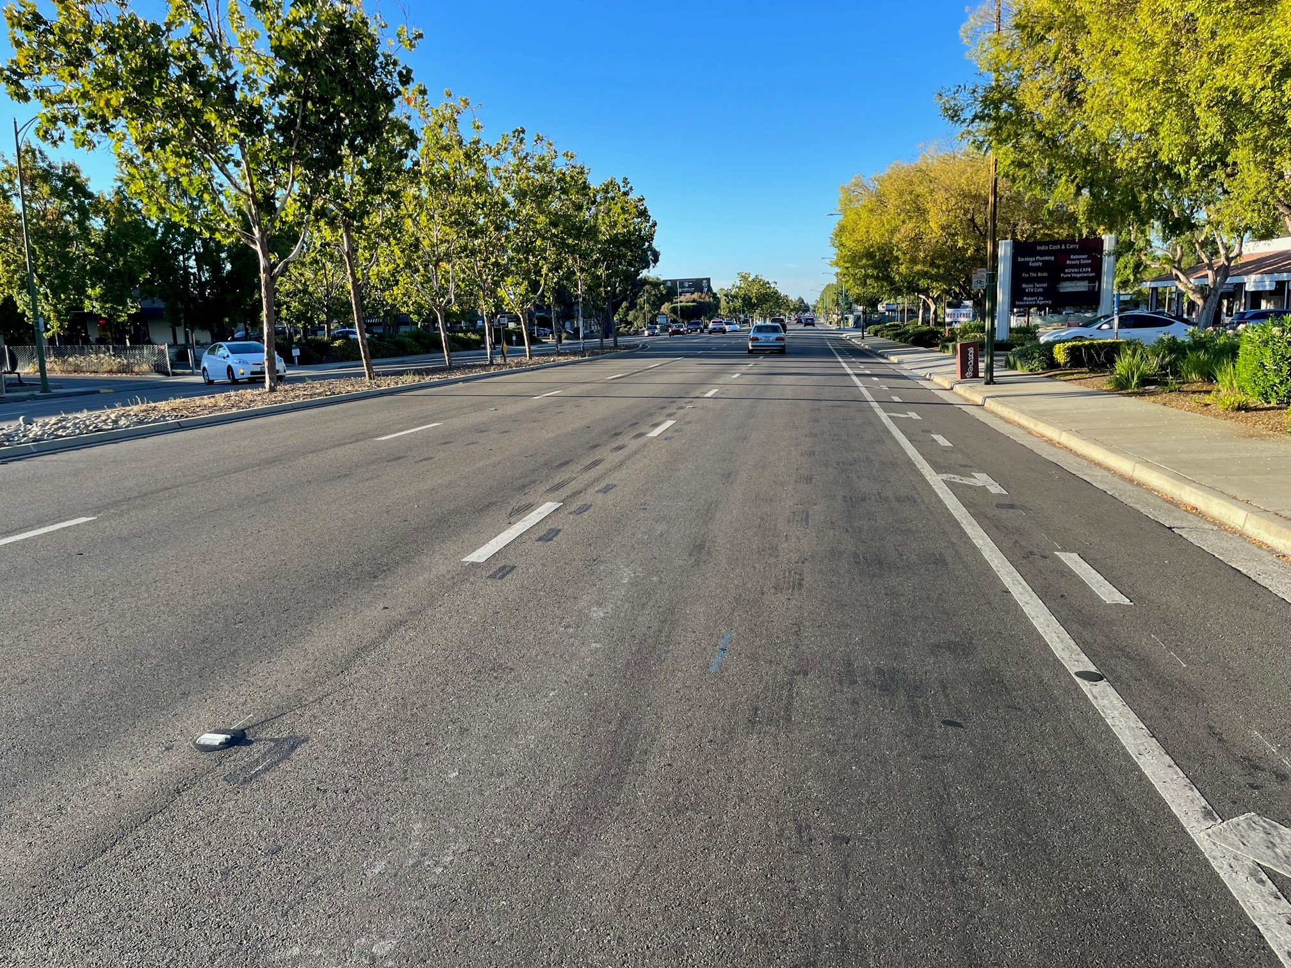
Project Description – What It Is

Slide 9
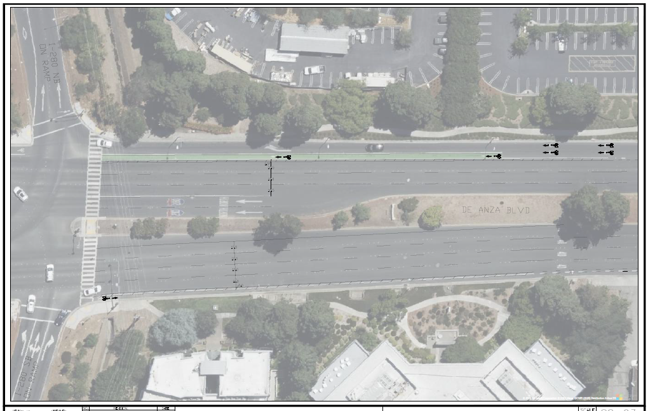
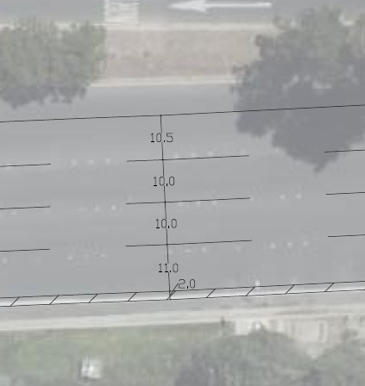
Project Details – 4-Lane Sections

Slide 10
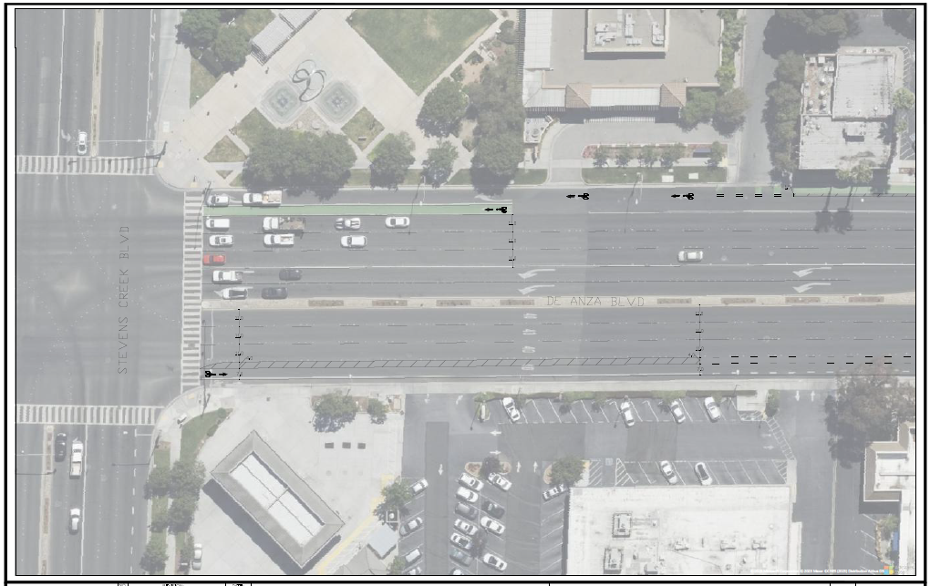
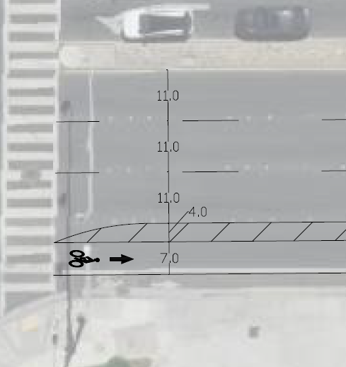
Project Details – 3-Lane Sections

Slide 11
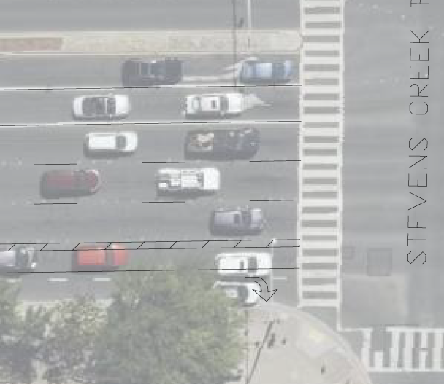
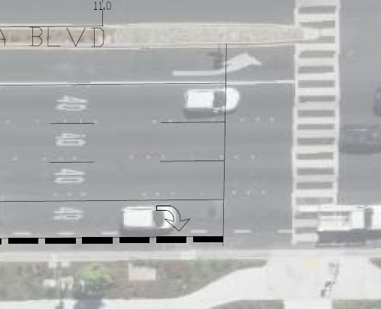
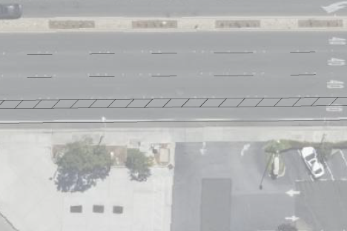
Project Details – Right-Turn Treatment
McClellan Rd
Right-turn pocket
Stevens Creek Blvd
No barriers to restrict movements
Typical Driveway/Intersection

Slide 12
Traffic Effects
De Anza Blvd/Sunnyvale-Saratoga Rd
  3 lanes existing each direction north and south of project area
Current project aligns and is consistent with these existing configurations
Analysis performed to ensure adequate design
  Standard HCM methods utilized
  3 lanes adequate to accommodate traffic flow
  V/C < 1.0 during peak 15-minute periods
Right-turn impacts reduced

Slide 13

Traffic Effects
What factors affect traffic progression?
  Operation of signalized intersections - greatest impact
  Number of thru lanes - lower impact
Existing signal timings optimized for balanced flow with current lane configurations
Signal readjustments will be considered following project implementation to ensure no increase in delays
Traffic redistributions along corridor will ensure total travel times remain constant

Slide 14
Next Steps
October implementation
4-6 week timeline
Work will be scheduled to minimize traffic impacts
Following completion, City will monitor traffic and travel time

Slide 15
Questions?
David Stillman
Transportation Manager
davids@cupertino.gov

